Slide 2
Fill Up your propagation toolbox
Glenn Cate – N4GRC
January 5, 2024

Slide 3
Solar Weather and Propagation Presentations
Session #1 – November 2023
Bob – KC4SXO – “What Do the Numbers Mean?” – Solar weather and solar numbers
Session #2 – December 2023
Ed – NZ1Q – “The Sun and HF Radio Propagation” – Solar weather effects on propagation
Session #3 – January 2024
Glenn – N4GRC – “Fill Up Your Propagation Toolbox” – Tools to use that can help us with solar weather, propagation and DX predictions

Slide 4
Propagation Toolbox: What to Cover
Basic Propagation Tools
Solar Activity Tools
PC Propagation Tools
Web-Based Propagation Tools
DX Activity Websites
Grayline DXing Websites
Propagation Resources (Books)
How I have my shack setup for propagation testing and DX operation

Slide 5
Propagation Toolbox: Basic Propagation Tools
Turn on your radio and check out the bands
“You can’t work ‘em if you can’t hear ’em.”
Do a quick solar weather number check (from Ed NZ1Q notes):
SFI (Solar Flux Index)
(70=poor / 90=good / 220=fabulous)
Planetary K-Index (Kp Index)
(1=calm / 5=minor storm / 7 = severe storm)
X-Ray Flux
(A1.1=good / C5.0=moderate / X2.3=severe)

Slide 6
Propagation Toolbox: Basic Propagation Tools (continued)
Do a quick CQ on a desired band to work
Get a response?
Check one of the logging sites to see if someone hears you
Check www.pskreporter.info for FT8 response on desired band
www.hf.dxview.org/perspective/Your_Grid_Square – real time propagation

Slide 7
Propagation Toolbox: Criteria for Tools Listed
Cost
”Free” is good!
Provides accurate and helpful information
Ease of installation and use
HF propagation sites
Favorites of N4GRC are highlighted in BLUE

Slide 8
Propagation Toolbox: Solar Activity Tools
SolarHam – www.solarham.net
Space Weather Live – www.spaceweatherlive.com
Space Weather Prediction Center (NOAA) – www.swpc.noaa.gov
NASA – www.soho.nascom.nasa.gov/spaceweather
Space Weather News – www.spaceweathernews.com
Space Weather (Dr. Tony Phillips) – www.spaceweather.com

Slide 9
Propagation Toolbox: Solar Activity Tools (continued)
Solar Weather Chart – www.hamqsl.com/solar.html
This is the site that Bob KC4SXO used in his presentation
SunSpotWatch – www.prophfradio.org
Google Play – spaceweather.app
Google Play or Apple App Store – SpaceWeatherLive or Solar Activity
Dr. Tamitha Skov (a.k.a. the “Space Weather Woman”)
Ham callsign: WX6SWW

Slide 10
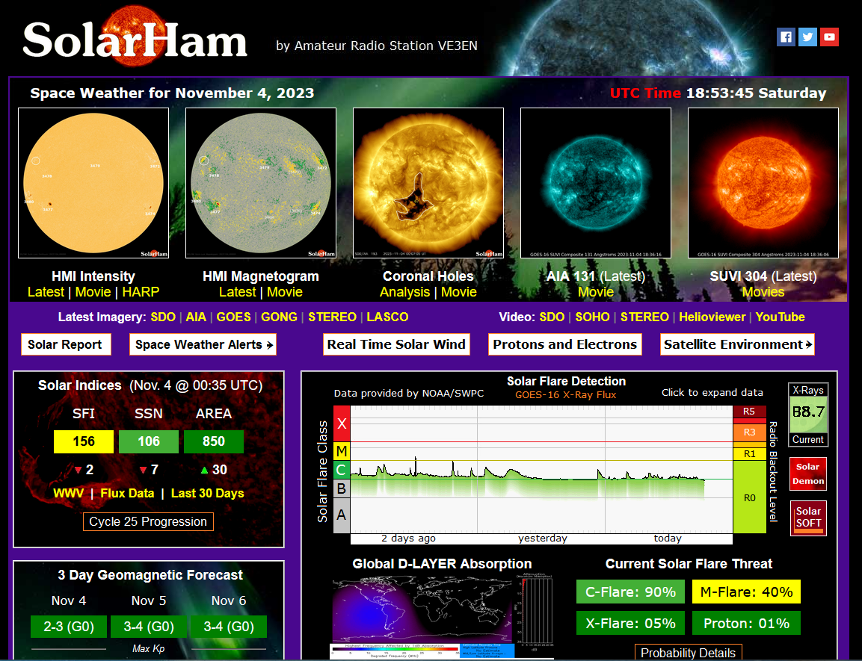

Slide 11
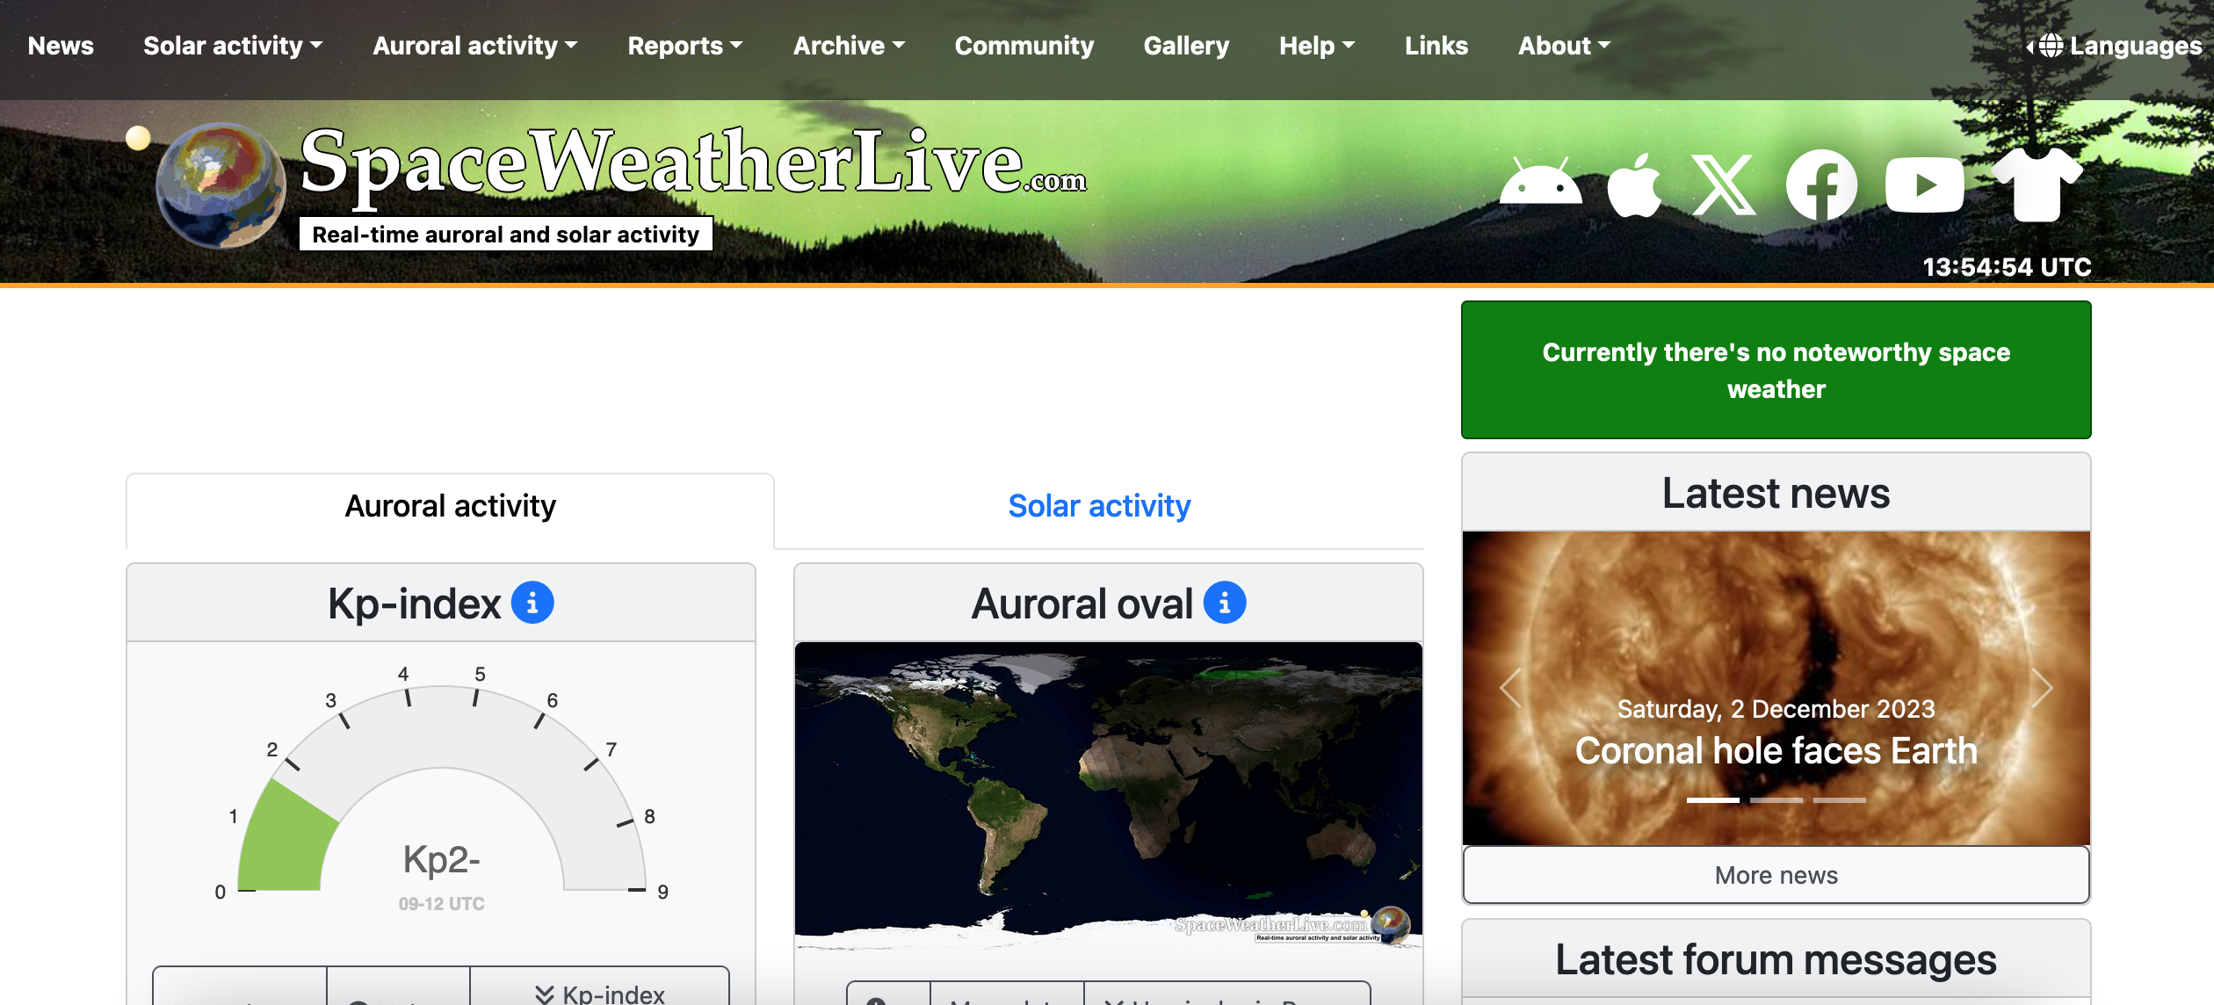

Slide 12
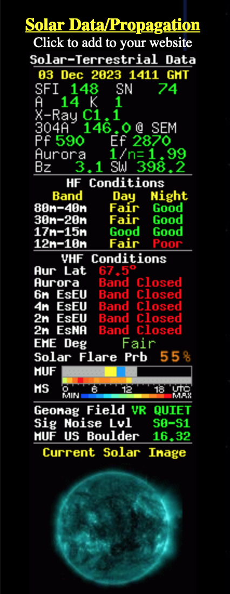

Slide 13
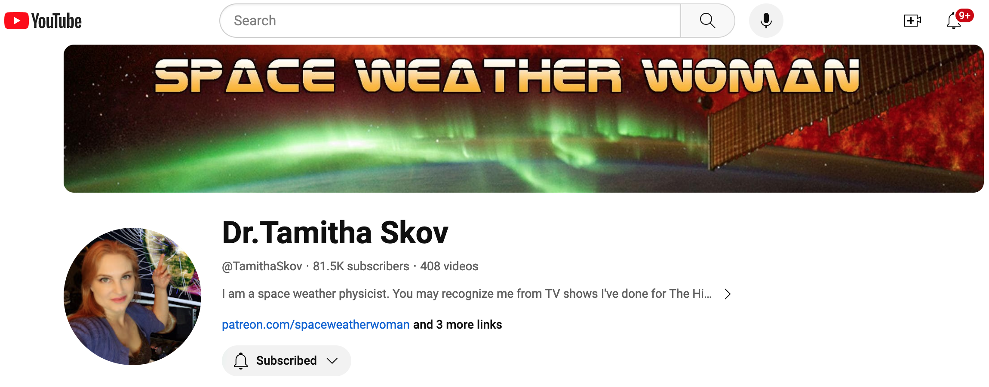

Slide 14
Propagation Toolbox: PC Propagation Tools
GridTracker – www.gridtracker.org
Note: App is not digitally signed in Windows
DX Suites – PropView (uses VOACAP) www.dxlabsuite.com
Use PropView with DXView
Live presentation
DX Toolbox – www.blackcatsystems.com ($24.99)
DXProp/PropHF – www.f6gqk.fr/propag.html

Slide 15
Propagation Toolbox: PC Propagation Tools (continued)
VOACAP – www.voacap.com (install app on your PC)
VOACAP Online – www.voacap.com/hf
Live presentation

Slide 16
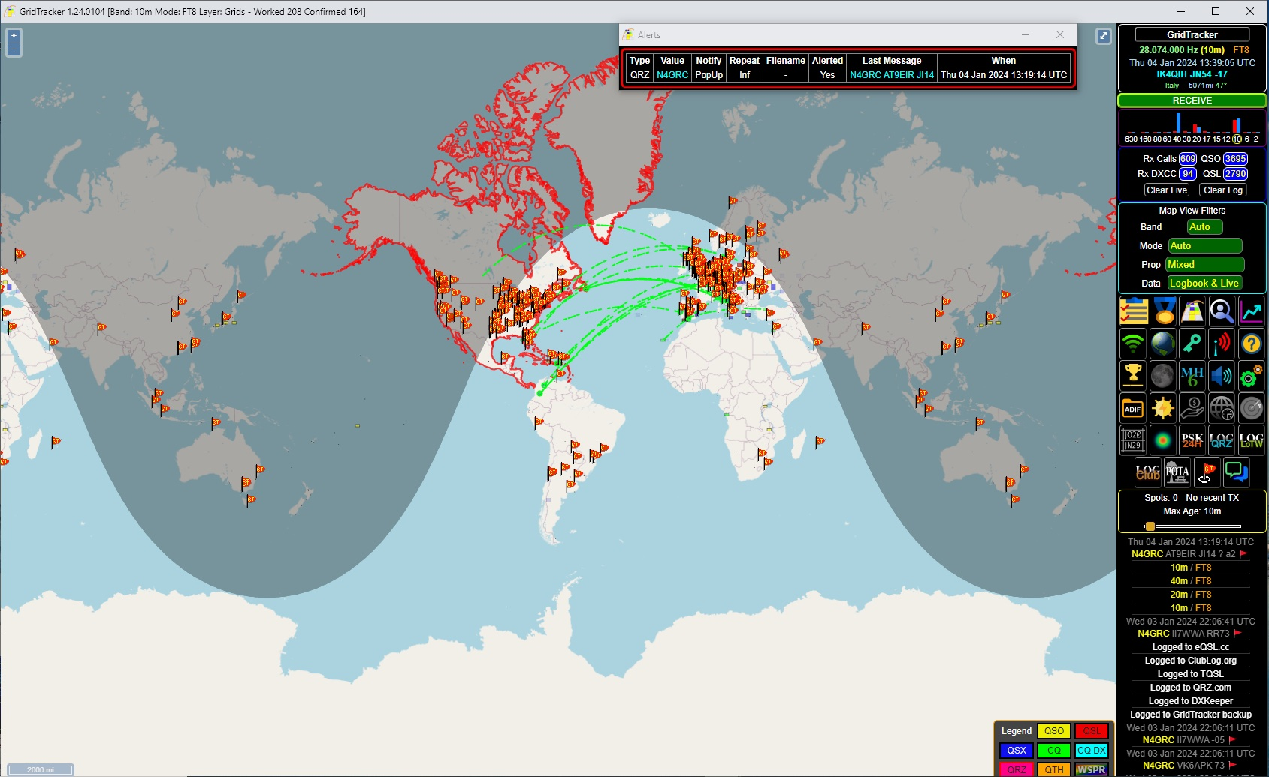

Slide 17
Propagation Toolbox: Web-Based Propagation Tools
Proppy (uses VOACAP) – www.soundbites.asia/proppy
W6ELProp – www.qsl.net/w6elprop
Amateur Radio: Usable HF Frequencies – www.hfpropagation.com
HamCap – www.dxatlas.com/HamCap

Slide 18
Propagation Toolbox: Web-Based Propagation Tools (continued)
PSK Reporter – automatically display reception reports of digimode activity – www.pskreporter.info
Live presentation
HF DX View – This map shows real-time radio propagation from stations operating on 11 bands between 1.8 and 54 MHz in the amateur radio service. – https://hf.dxview.org/perspective/EL87ps
EL87ps is my grid square – replace with your grid square in the URL
Live presentation
Reverse Beacon Network – RBN is a network of stations listening to the
bands and reporting what stations they hear, when and how well. – www.reversebeacon.net

Slide 19
Propagation Toolbox: Web-Based Propagation Tools (continued)
WSPRnet – Weak Signal Propagation Reporter Network. Used to broadcast a position, call sign and power level and see who hears and decodes it. Tracked on www.wsprnet.org. Uses WSJT-X software.
www.dx.qsl.net/propagation – Propagation and Solar Weather
DX.QSL.NET – Propagation – VHF, UHF and
microwave forecasting – https://dxinfocentre.com/tropo.html

Slide 20
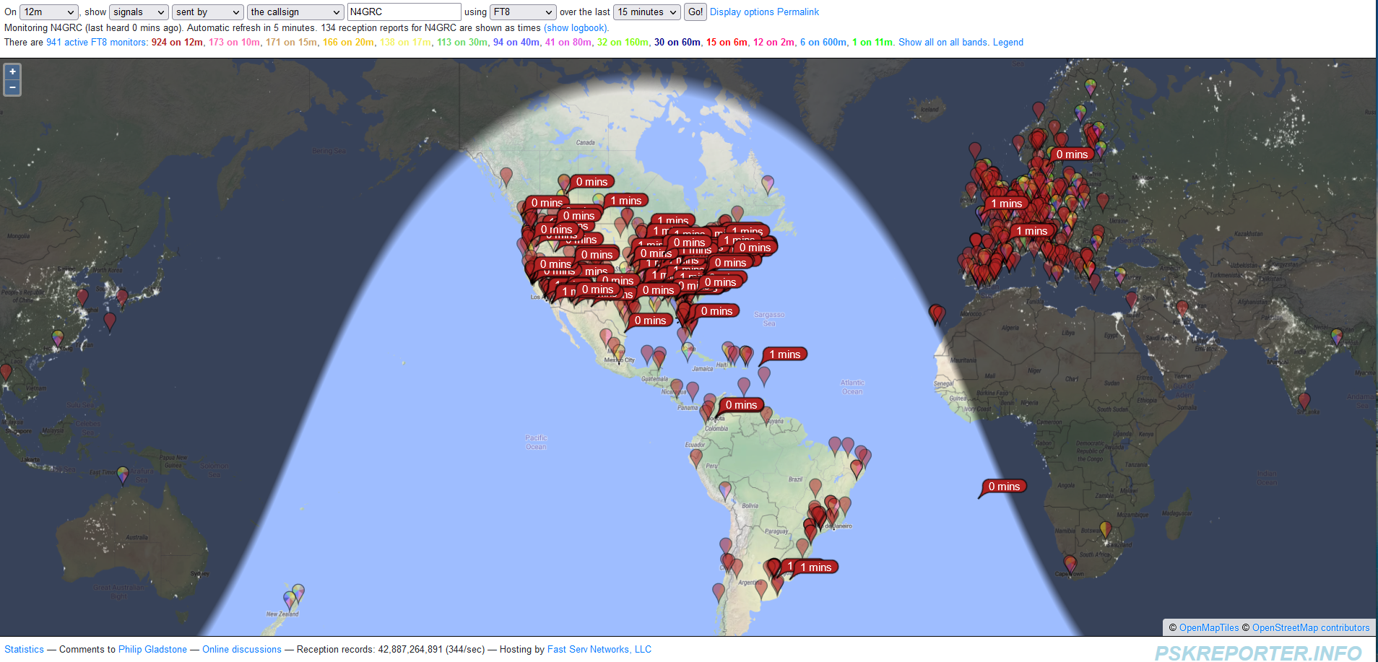

Slide 21
Propagation Toolbox: DX Activity Websites
ADXO – Announced DX Operations – Lists recent DXpeditions with links to DX Watch spot database for active operations. www.ng3k.com/Misc/adxo.html
Live presentation
HamSpots – digital mode spotter network. www.hamspots.net
Live presentation
DX Watch – DX clusters, filters, DX spots in real time. www.dxwatch.com
DX Summit -- customize with filters, specific station, etc. www.dxsummit.fl
DX News – latest DXpeditions and recent DX spots. www.dxnews.com
DX World – breaking DX news. www.dx-world.net

Slide 22
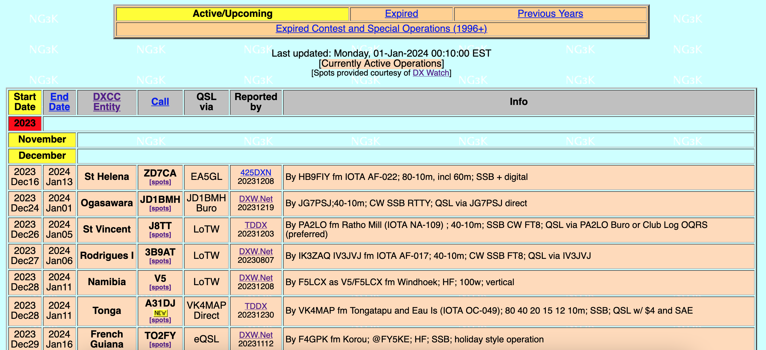

Slide 23
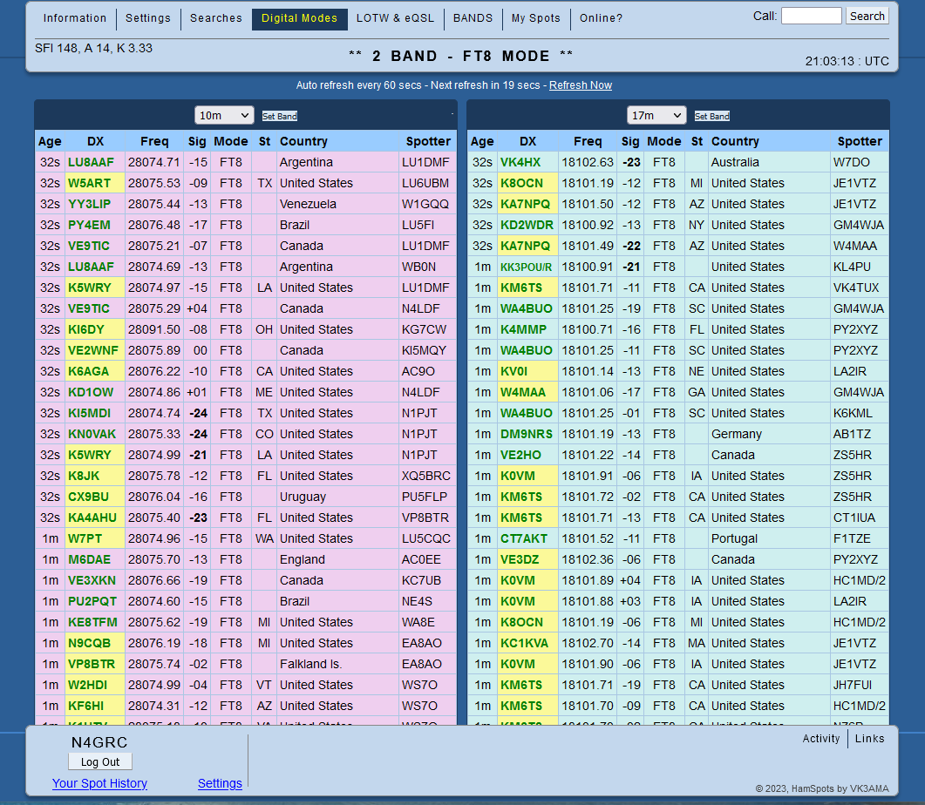

Slide 24
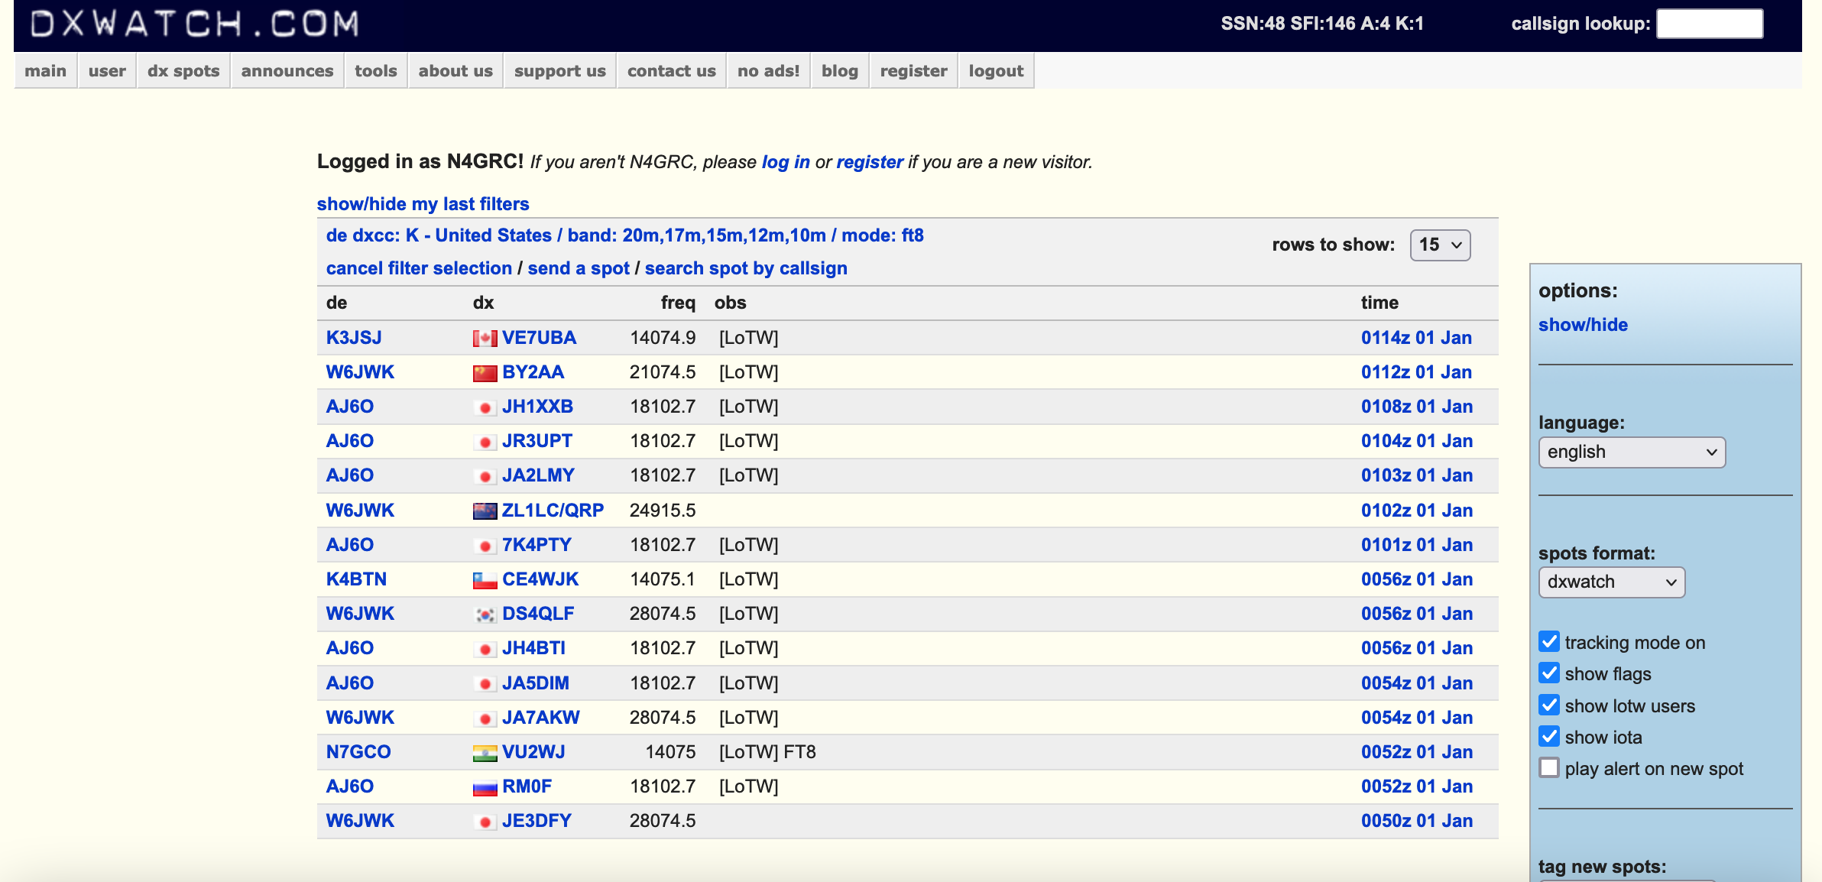

Slide 25
Propagation Toolbox:
Show apps and websites

Slide 26
Propagation Toolbox: Grayline DXing Websites
Grayline propagation is when the ionosphere is in a state of transition (sunrise and sunset) as some areas are still reflecting radio waves while others have started to absorb them. Grayline propagation is a “sweet spot” that allows HF communication to travel farther than at other times during the day.
Grayline HF Propagation – https://www.electronics-notes.com/articles/antennas-propagation/ionospheric/greyline-propagation.php
An Introduction to Grayline DXing – https://www.robkalmeijer.nl/techniek/electronica/radiotechniek/hambladen/qst/1992/11/page80/index.html
Working the Grayline – http://www.astrosurf.com/luxorion/qsl-propa5.htm

Slide 27
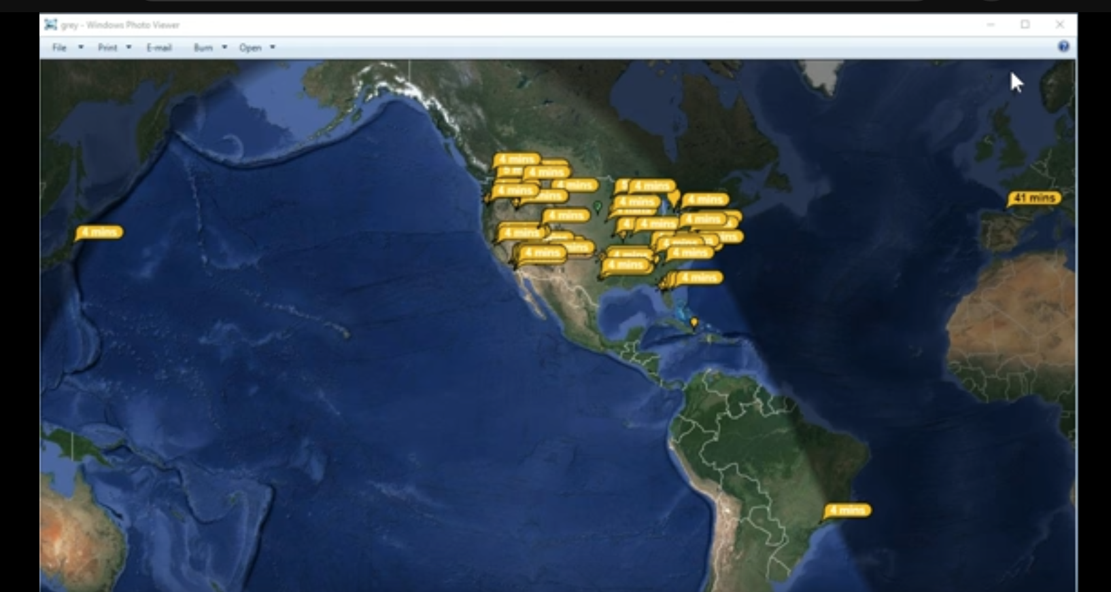

Slide 28
Propagation Toolbox: Propagation Resources
Silver, Ward, N0AX. Here to There: Radio Wave Propagation (2023) Newington, CT: The American Radio Relay League, Inc.
Luetzelschwab, Carl, K9LA et al. The CQ Shortwave Propagation Handbook – 4th Edition (2021) Northport, NY: CQ Communications, Inc.

Slide 29
Propagation Toolbox:
How I Have My Shack Setup for Solar Weather, Propagation Testing and DX Operations

Slide 30
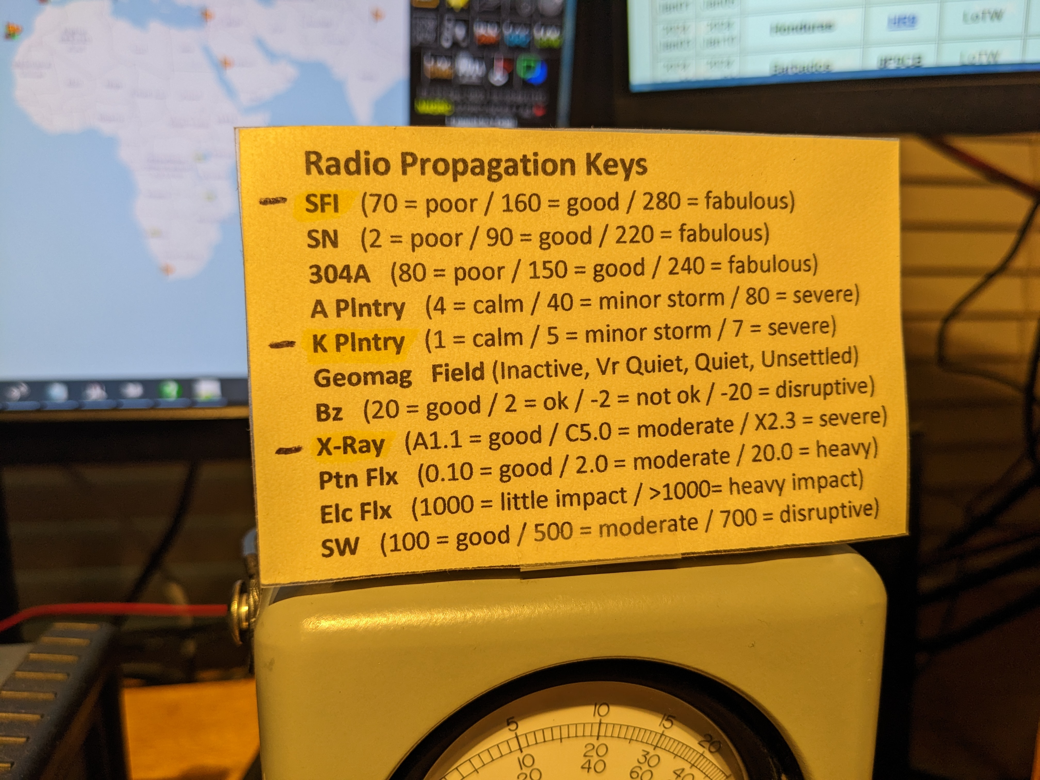

Slide 31
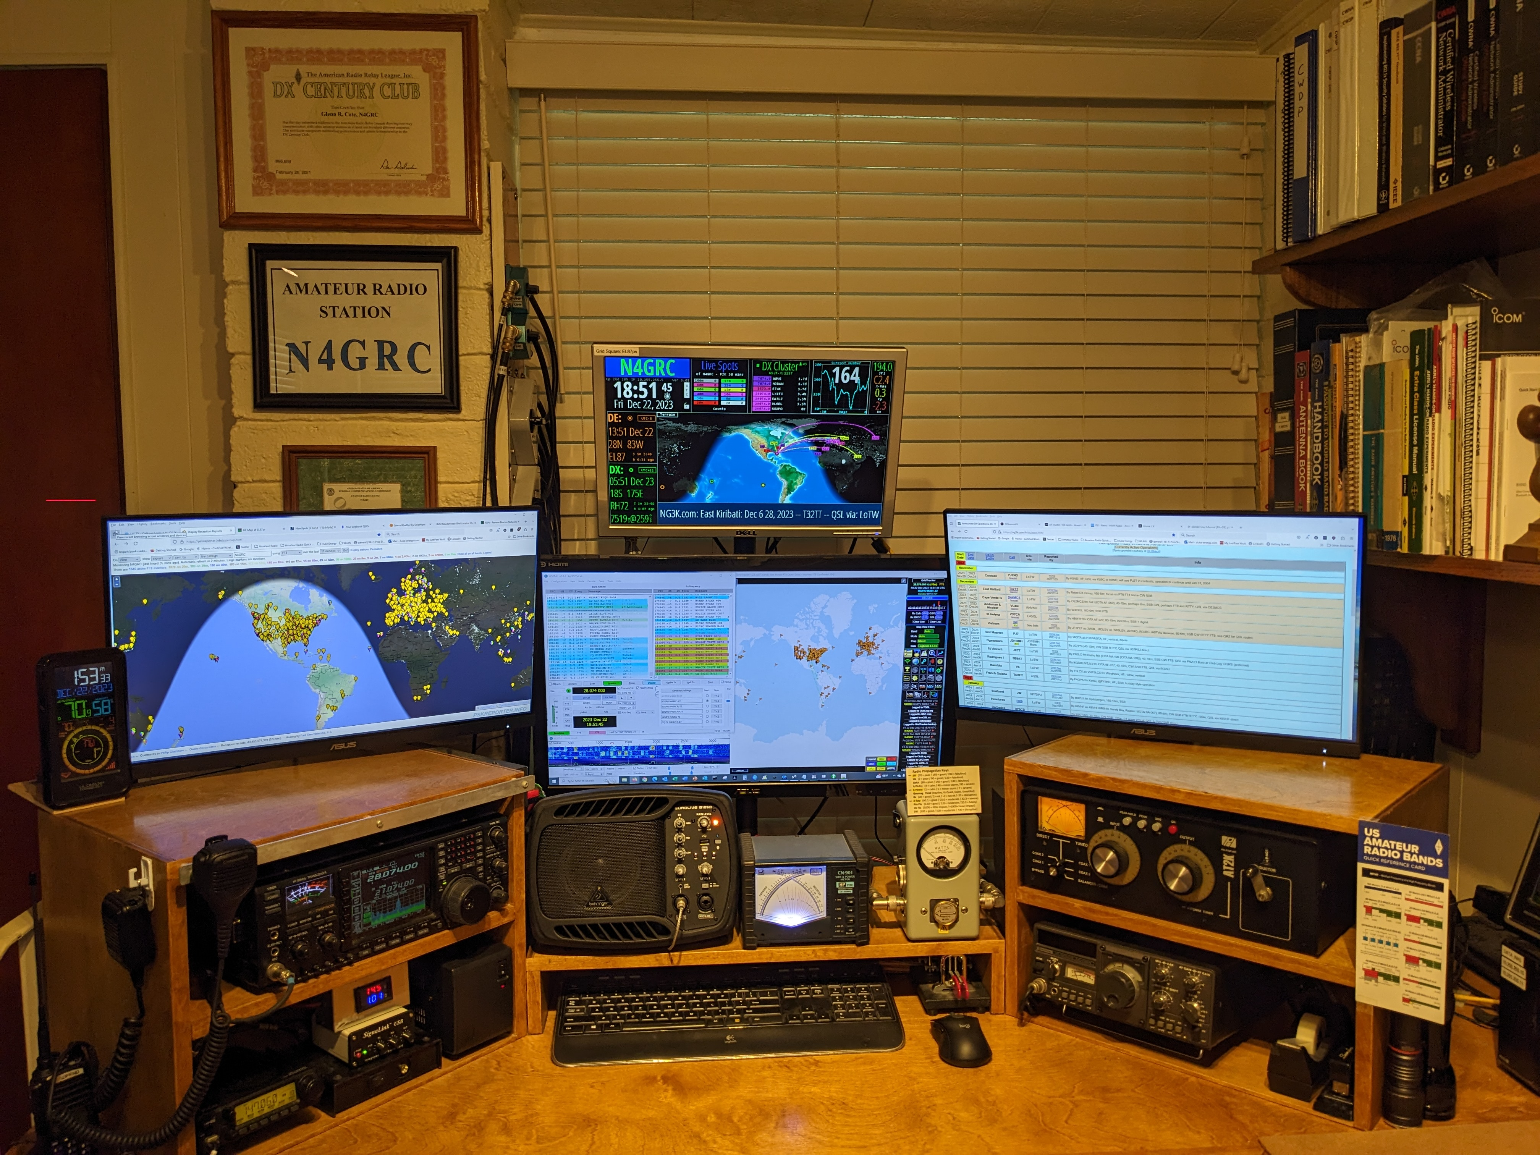

Slide 32
Propagation Toolbox:
Questions ?

Slide 33
Now, go out and fill up your own…
“Propagation Toolbox” !
73 DE N4GRC

