Slide 1
HF Propagation and the Sun
Ed nz1q
December, 2023
How radio waves travel and are affected by Solar activity

Slide 2
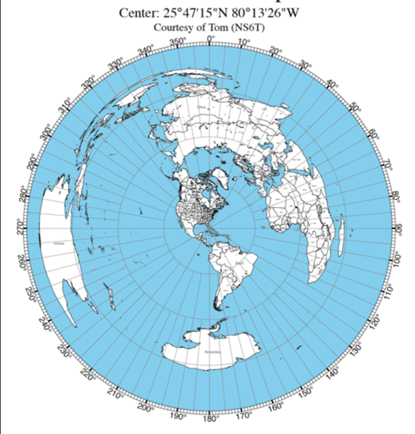
How We Get From Here to There
HF Radio Wave
Propagation
bend

Slide 3
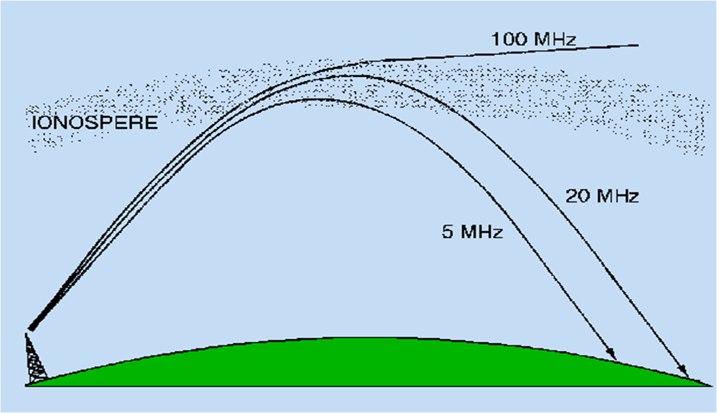
Bending waves and skip
skip

Slide 4
critical

Slide 5
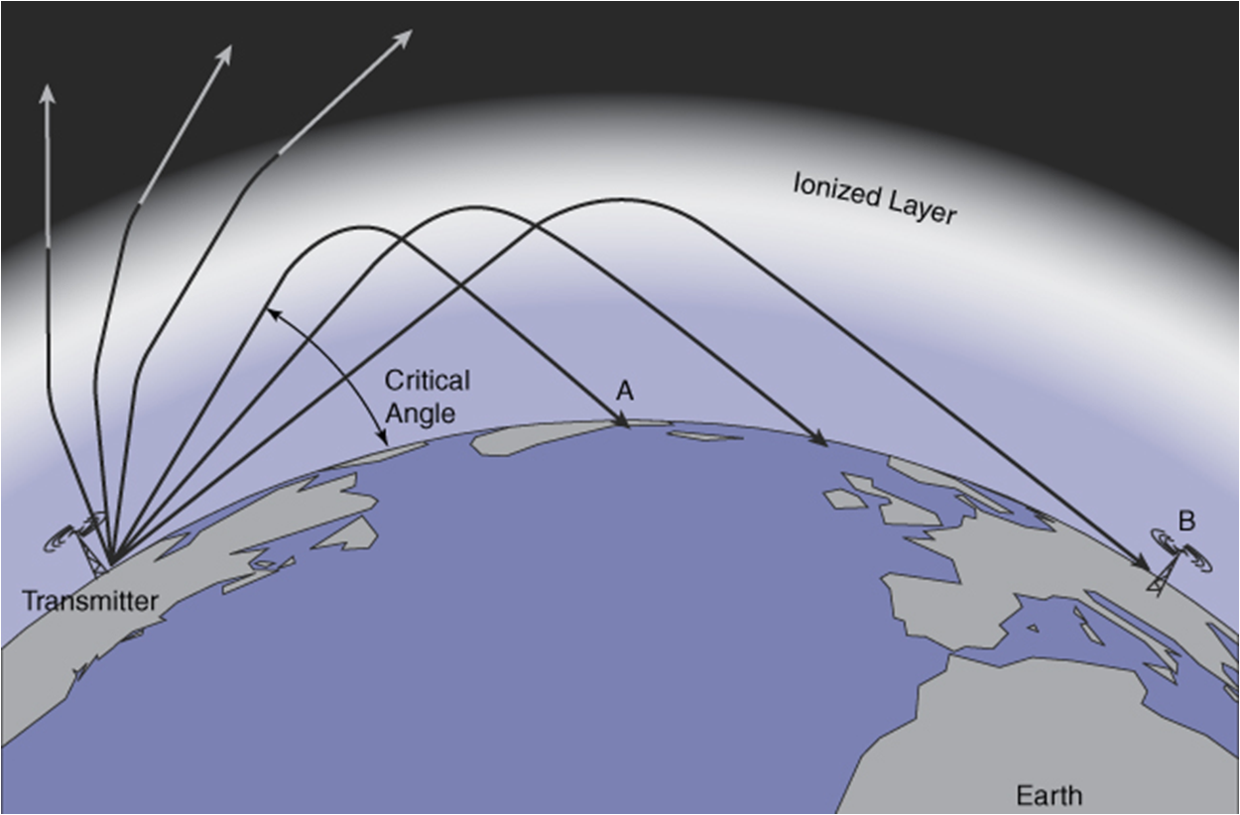
Critical Angle at one Frequency
layers

Slide 6
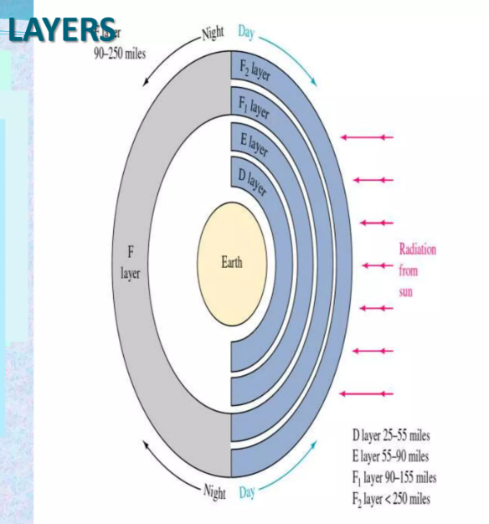
Day Night Layers
Day night

Slide 7
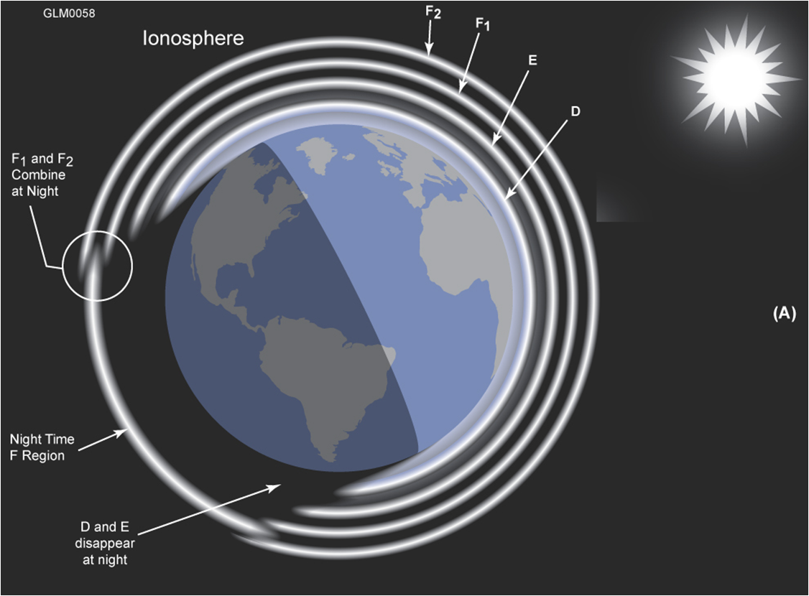
Closer

Slide 8
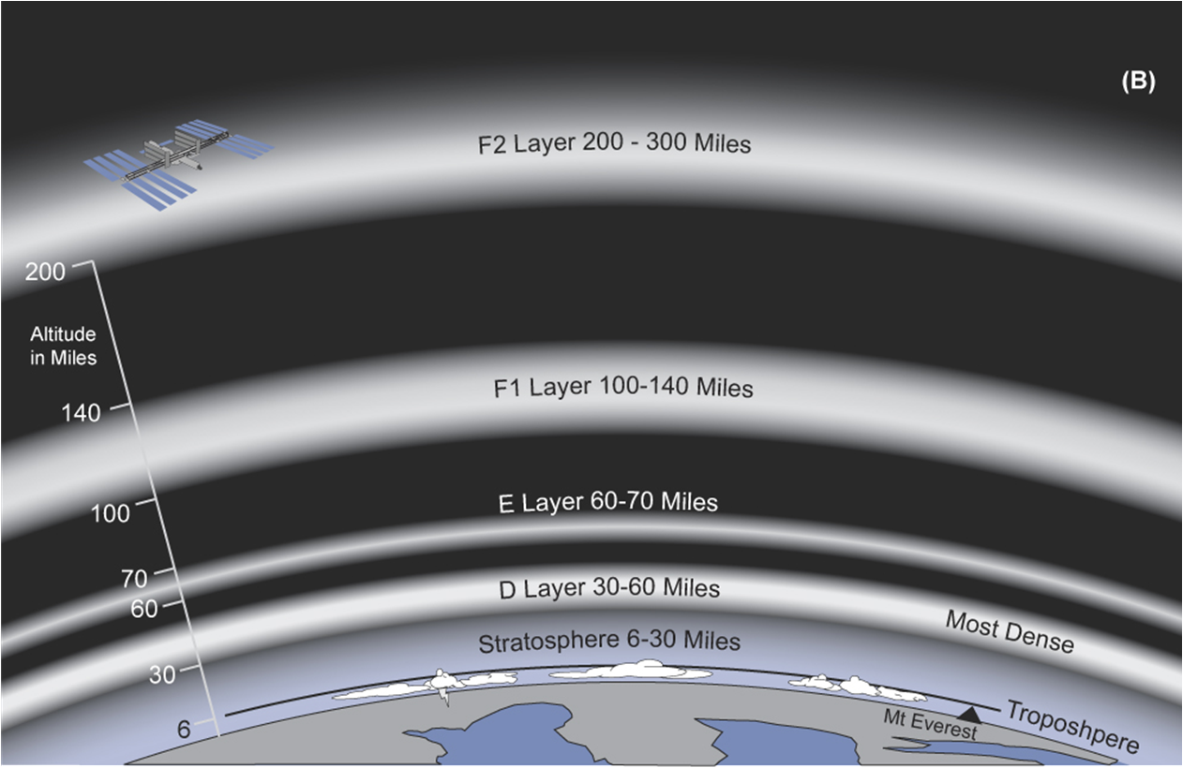
cycles

Slide 9
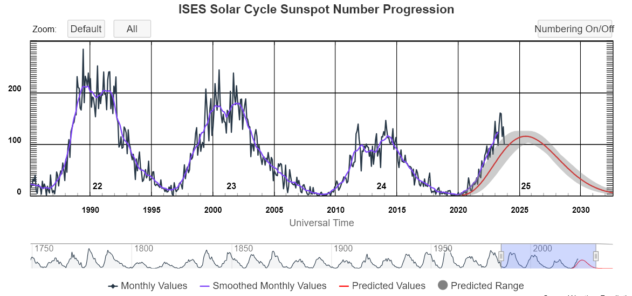
Sun spots

Slide 10
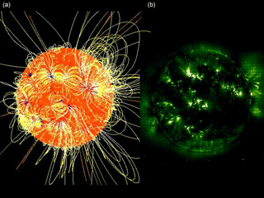
Sun Spots and Magnetic Fields
Mag field

Slide 11
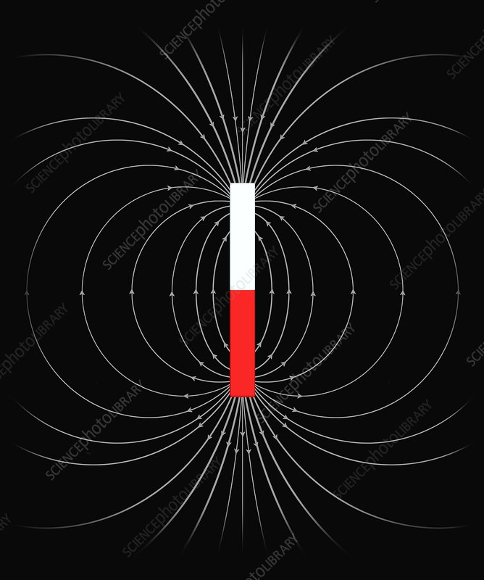
Earth’s Magnetic Field Lines
Wind & CME

Slide 12
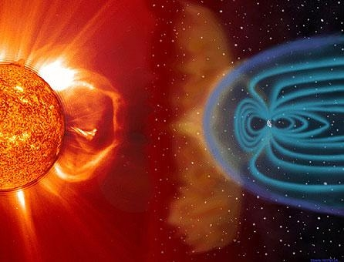
Solar Wind and CMEs
Wind & CME

Slide 13
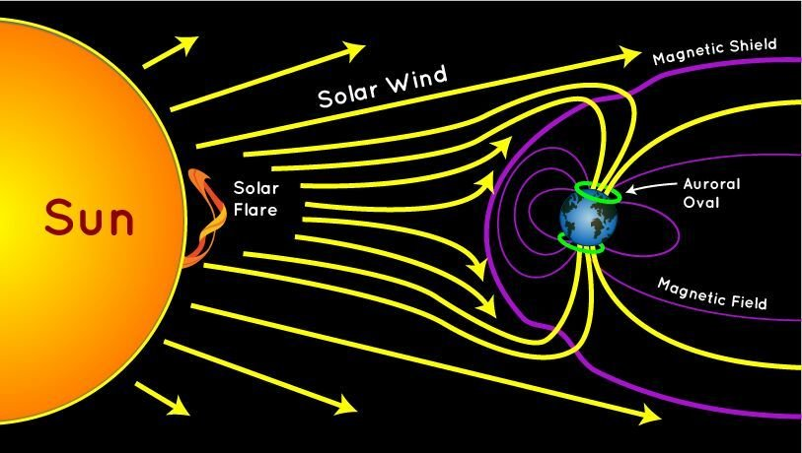
Wind & cme

Slide 14
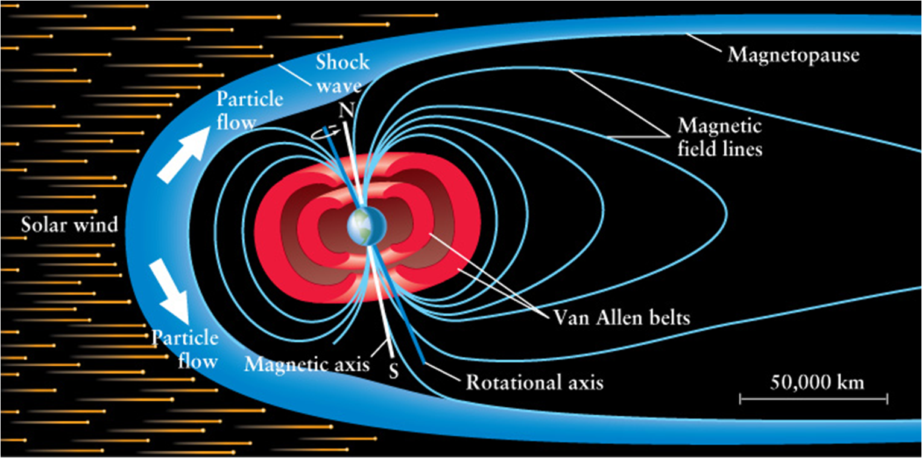
Van Allen Radiation Belts
aurora
Notes:
The Van Allen radiation belts are regions of charged particles, primarily electrons and protons, that are trapped by Earth's magnetic field. These belts were discovered by American physicist James Van Allen in 1958 using data from the first U.S. satellite, Explorer 1.
The Van Allen radiation belts consist of two main components:
Inner Belt: The inner radiation belt is primarily composed of high-energy protons. These protons are trapped by the Earth's magnetic field lines in a doughnut-shaped region extending from about 1,000 to 8,000 kilometers above the Earth's surface.
Outer Belt: The outer radiation belt, located farther from the Earth than the inner belt, contains mostly high-energy electrons. These electrons are also trapped by the Earth's magnetic field and form a second doughnut-shaped region, extending from about 13,000 to 60,000 kilometers above the Earth.
These charged particles are captured and held in place by the Earth's geomagnetic field, creating two concentric belts of radiation. The primary source of these charged particles is the solar wind, a stream of charged particles (mostly protons and electrons) continuously flowing from the Sun. When these particles interact with the Earth's magnetic field, they can become trapped and form the Van Allen radiation belts.
The intensity and structure of the Van Allen radiation belts can vary in response to solar activity, such as solar flares and coronal mass ejections. During geomagnetic storms, the belts may become more intense, and their boundaries can fluctuate.
While the radiation belts pose challenges for spacecraft and satellites passing through them, they also play a crucial role in protecting the Earth's surface from the solar wind by trapping and preventing most of the solar wind particles from reaching the atmosphere.

Slide 15
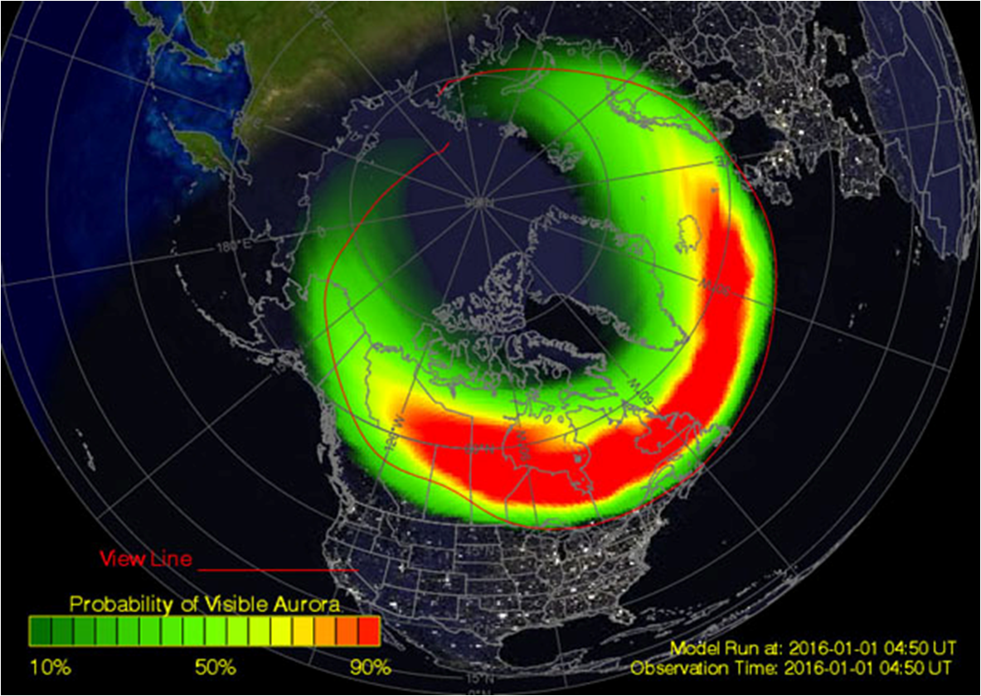
bad

Slide 16
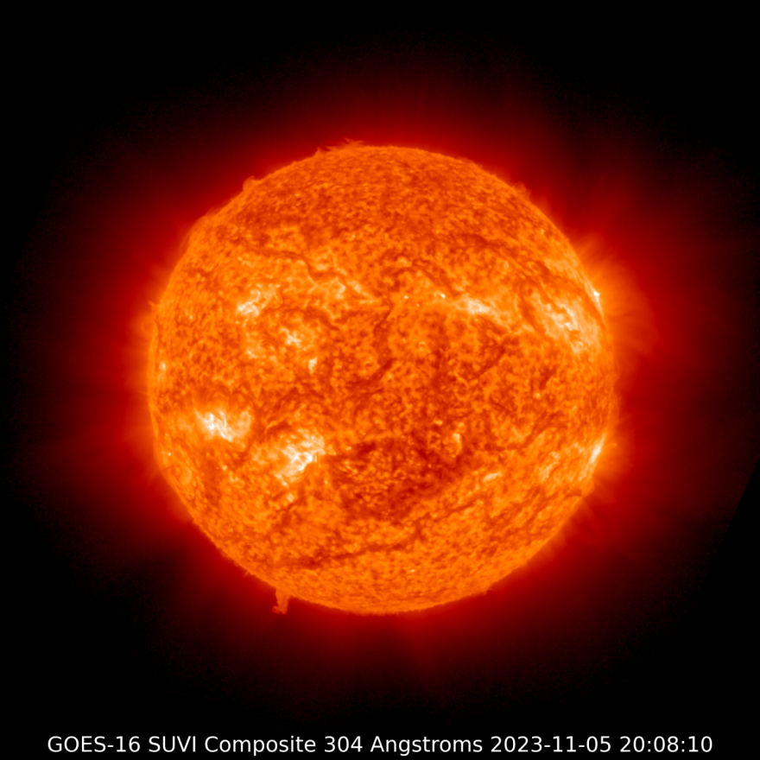
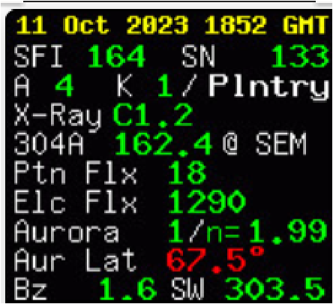
Degrades Propagation
Flares
CMEs
Solar Wind
Good

Slide 17
What affects Radio Propagation?
Solar Flux (SFI)
UV
Sun Spot Number
Solar Wind (SW)
Coronal Holes
Coronal Mass Ejections (CME)
Sun Spot Eruption
Plasma + Magnetic Flux
Solar Flares
X-Rays from Sun Spots
wind

Slide 18
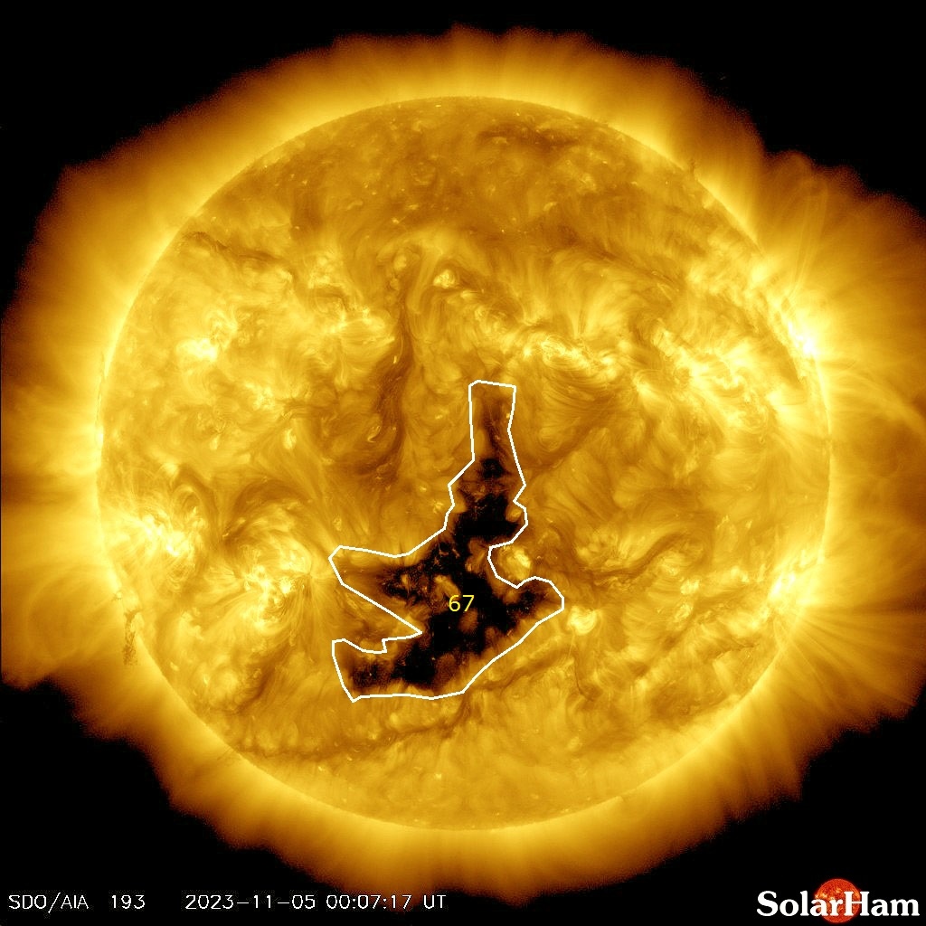
sprial

Slide 19
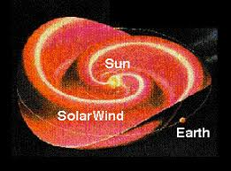
Wind specs

Slide 20
Solar Wind = Plasma
400 kilometers per second
=250 Miles per second
= 900,000 miles per hour
Protons & Electrons
Less dense than the best man-made Vacuum
Common speeds of 300 to 400 k/s
Fastest speeds of 500 to 800 k/s
CMEs can inc speed to 4000 k/s
Vel den

Slide 21
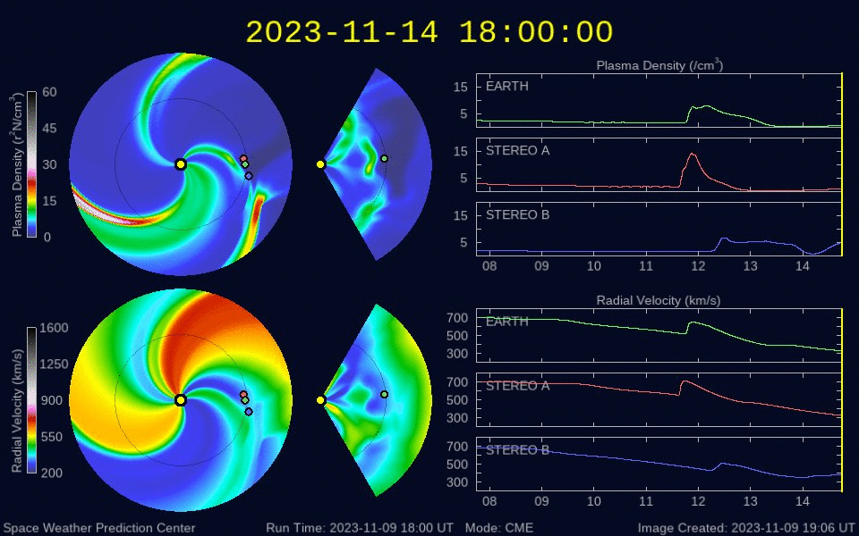
CME
Measure

Slide 22
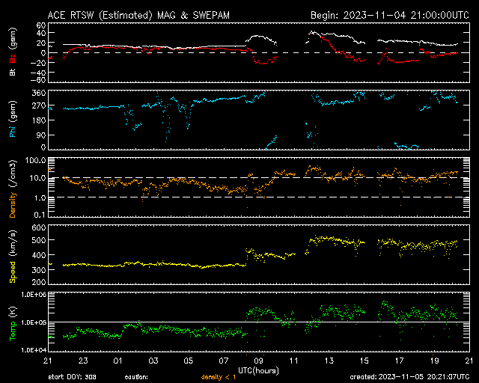
anamation
Notes:
The abbreviation "PRI" in space weather charts typically stands for "Proton Radiation Index." The Proton Radiation Index is a measure used in space weather monitoring and forecasting to describe and assess the radiation risk to astronauts and space missions caused by high-energy solar protons. Solar proton events, often associated with solar flares and coronal mass ejections (CMEs), can release high-energy protons into space, posing a risk to spacecraft and astronauts.
The Proton Radiation Index quantifies the intensity and severity of these solar proton events, which can impact space-based assets and human activities in space. It is an important parameter for assessing radiation exposure and helping space agencies and mission planners make informed decisions to protect astronauts and space equipment during space missions.
The Proton Radiation Index is typically reported with values representing the proton flux at specific energy levels, such as MeV (Mega-electronvolts), indicating the intensity of the radiation at those energy levels.

Slide 23
magnetometers

Slide 24
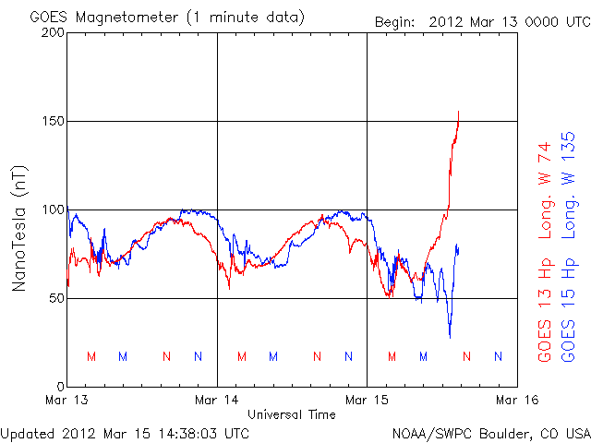
K bars

Slide 25
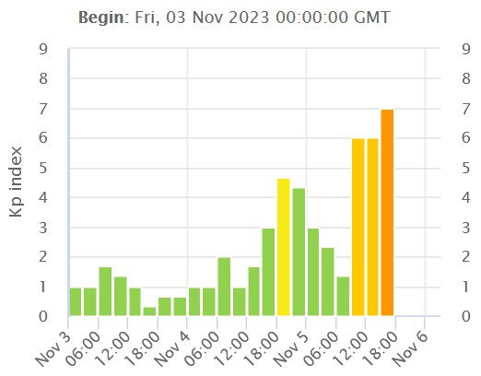
K index
K/mags

Slide 26
K index
today

Slide 27
Double CME Impact / Strong Storm in Progress
December 1, 2023 @ 00:00 UTC (UPDATED)Two CME passages observed. The first and smaller passage was observed at 00:21 UTC (Dec 1). A second and faster moving passage likely related to the M9.8 flare event on Nov 28 was observed.
A moderate (G2) geomagnetic storm is currently in progress. The solar wind speed is above 520 km/s and the Bz component of the interplanetary magnetic field (IMF) is pointing sharply south. A watch for strong (G3) conditions remains in effect. Aurora sky watchers at middle to high latitudes should be in for a treat while it is still dark outside.
ALERT: Geomagnetic K-index of 7
K

Slide 28
X-ray

Slide 29
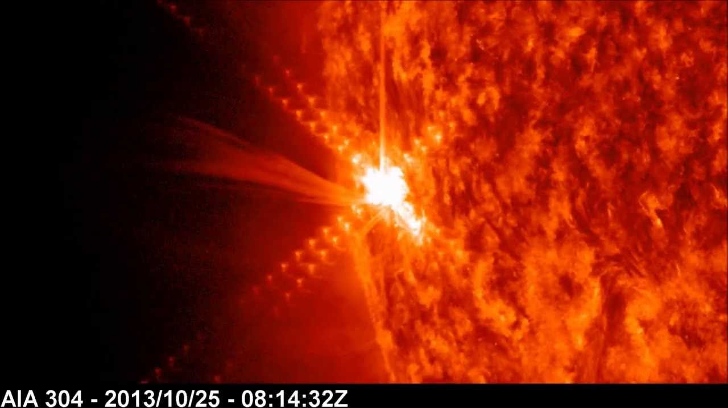
X-Rays
Flares - X-Ray Burst
Flares - May occur with or without a CME
Quiet Sun Spots - Soft X-rays and UV
X-ray

Slide 30
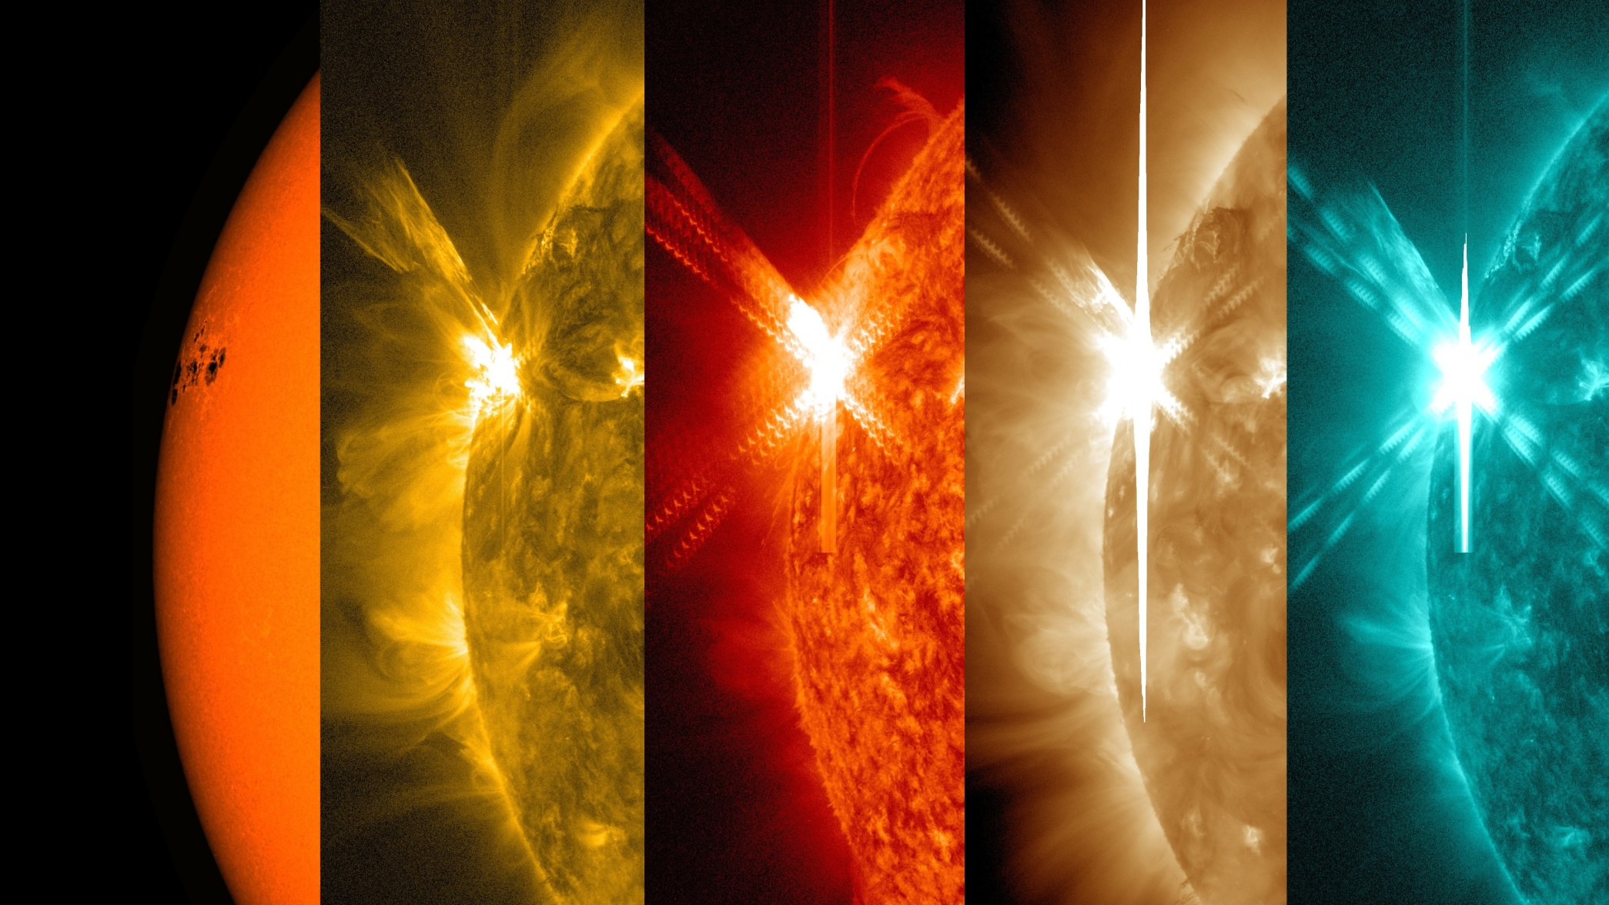
Solar Flare with wavelength filters
DRAP

Slide 31
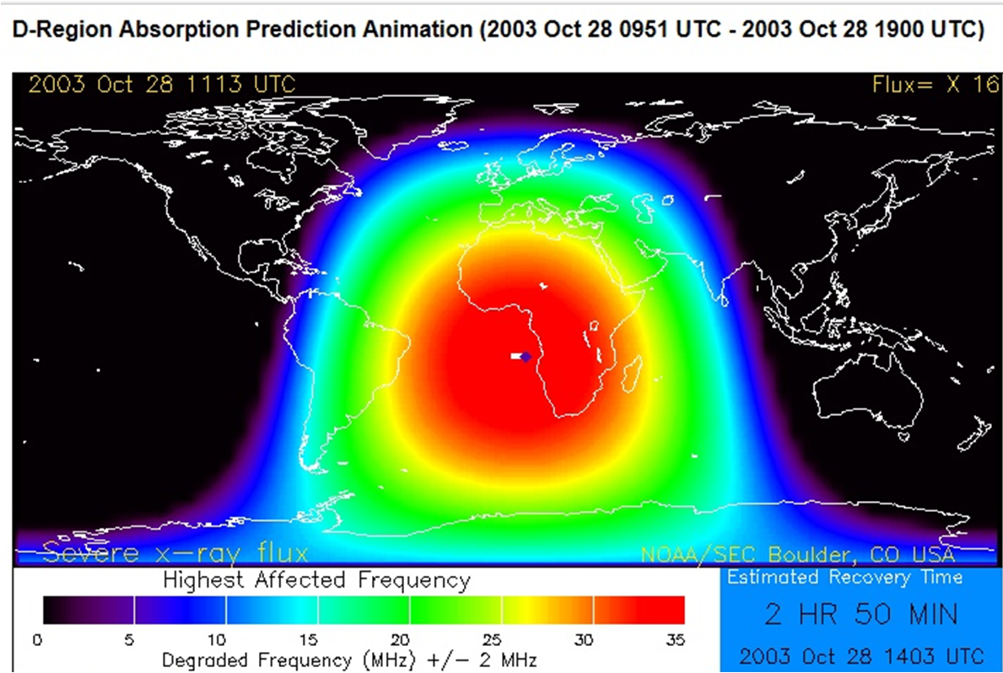
DRAP
Crit freq

Slide 32
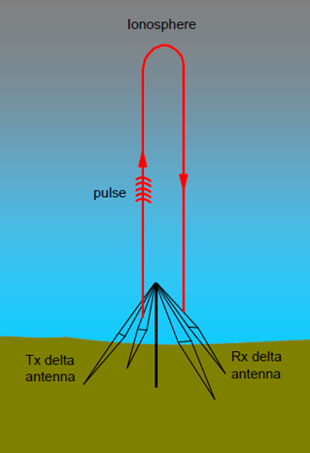
Critical Frequency & MUF
Critical Freq
A signal high enough in frequency such that the waves are not reflected back to earth.
MUF
Maximum Usable Freq
The maximum freq that can be used to the DX station.
MUF angle

Slide 33
MUF vs. Elevation angle (range)
Ionosonde

Slide 34
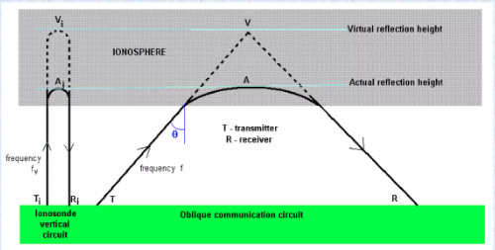
NVIS vs. Takeoff Angle
measurements

Slide 35
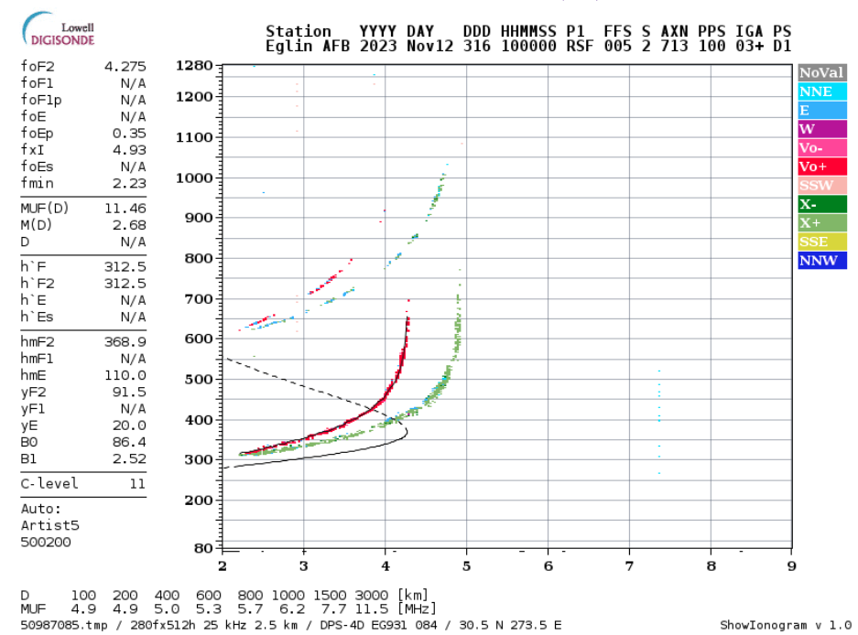

Slide 36
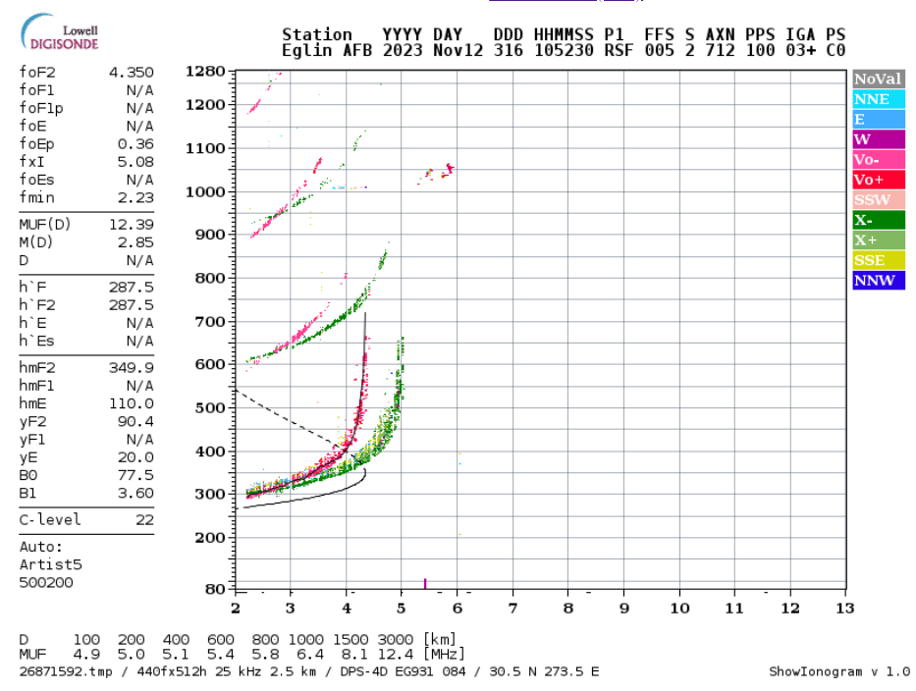

Slide 37
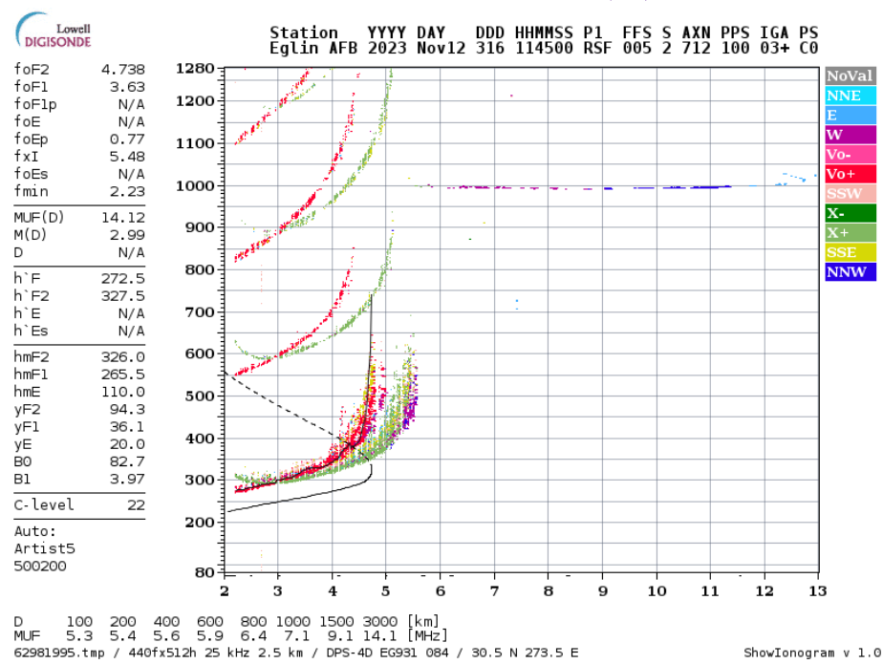
Rap

Slide 38
takeaway

Slide 39
The Nut Shell
SFI (70 = poor / 160 = good / 280 = fabulous)
SN (2 = poor / 90 = good / 220 = fabulous)
304A (80 = poor / 150 = good / 240 = fabulous)
A Plntry (4 = calm / 40 = minor storm / 80 = severe)
K Plntry (1 = calm / 5 = minor storm / 7 = severe)
Geomag Field (Inactive, Vy Quiet, Quiet, Unsettled)
Bz (20 = good / 2 = ok / -2 = not ok / -20 = disruptive)
X-Ray (A1.1 = good / C5.0 = moderate / X2.3 = severe)
Ptn Flx (0.10 = good / 2.0 = moderate / 20.0 = heavy)
Elc Flx (1000 = little impact / >1000= heavy impact)
SW (100 = good / 500 = moderate / 700 = disruptive)

Slide 40
END

Slide 41
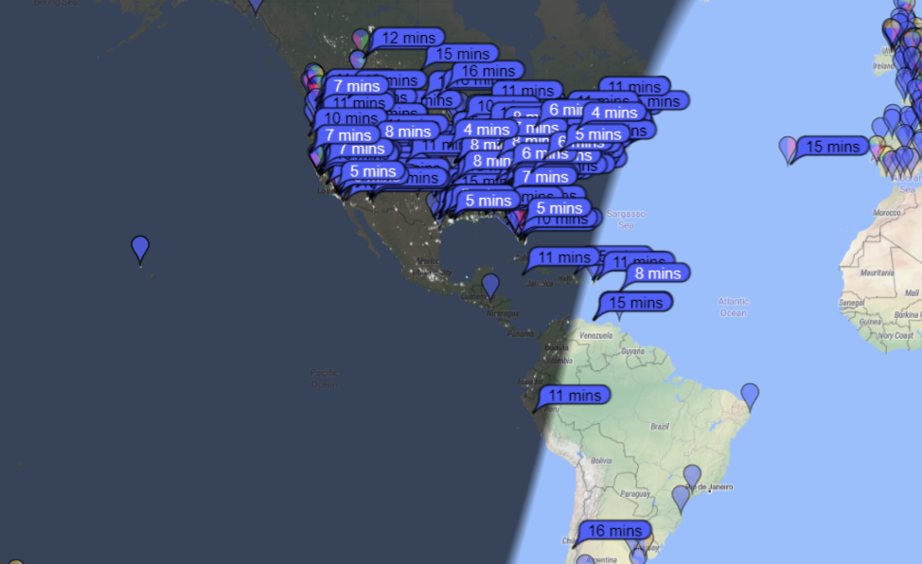
K=1.3, SS 74, SF 135, 6:30 am, 40m Vert, 35W, PSK Reporter 10/30/23

Slide 42
227/15min 7:20 am

Slide 43
141/15min

Slide 44
264/15min

Slide 45
A Few Minutes Later

