Slide 2
Everything You Always Wanted To Know About
Wi-Fi
Glenn R. Cate, N4GRC
May 4, 2018

Slide 3
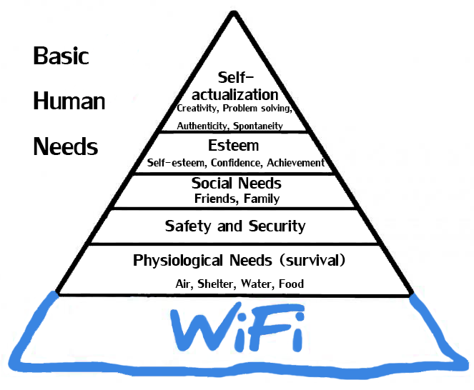

Slide 4
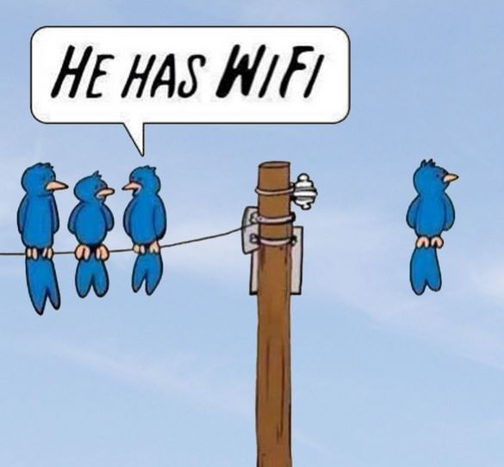

Slide 5
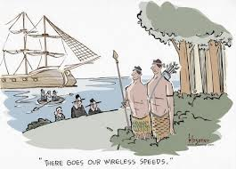

Slide 6
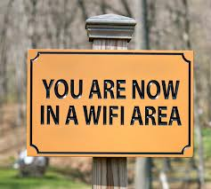

Slide 7
My Call Sign History
WN4NGW
WB4NGW
KA9FNL
KA9FNL/HI8
N4GRC

Slide 8
My IT Certifications
CWNE #181
CWNA, CWAP, CWSP, CWDP
CompTia A+
Microsoft MCSE
Cisco CCNA
“I’m a ham!!”

Slide 9
“Wi-Fi isn’t hard. How hard is it to not install wires?”

Slide 10
Agenda
History of Wi-Fi
Wi-Fi in Our Lives
How Wi-Fi Works
Wi-Fi as a Career
Can you “Fix” My Wi-Fi?
Q&A

Slide 11


Slide 12
It all Began with Hedy Lamarr
Austrian actress (1914-2000)
Co-invented with George Anthiel method to jam WWII Axis torpedoes
Used FHSS; part of legacy Wi-Fi and Bluetooth today
Notes:
No, Hedy Lamarr did not “invent” FHSS (it was around before this time), but she did invent the usage for jamming Axis torpedes in WWII.
Technology not adopted by US Navy until the 1960s
FHSS was part of legacy Wi-Fi and is part of Bluetooth technology
Lamarr was inducted into the National Inventors Hall of Fame in 2014

Slide 13
History of Wi-Fi
Wi-Fi does not mean “Wireless Fidelity”
Interbrand was contracted by Wi-Fi Alliance (WFA) circa 1999 for brand creation
Per WFA, “Wi-Fi doesn’t stand for anything.”
WFA used tag line: “Standard for Wireless Fidelity”
WFA approved “Wi-Fi” and the yin yang logo
Wi-Fi (with hyphen)
Notes:
WiFi Alliance wanted a term a bit catchier than “IEEE 802.11b Direct Sequence Spread Spectrum” and contracted Interbrand to come up with a better term.
For a while, WFA used tag line: “Wi-Fi: The Standard for Wireless Fidelity” but realized that was confusing things and was a mistake, so they dropped it.
Spell Wi-Fi as upper case W, lower case i, hyphen, upper case F, lower case i.

Slide 14


Slide 15
OSI Layers
7. Application Layer
6. Presentation Layer
5. Session Layer
4. Transport Layer
3. Network Layer
2. Data Layer
1. Physical Layer (PHY)
Notes:
IoT: door locks, refrigerators, HVAC and home A/C, wearable devices, security cameras, etc
“All People Seem To Need Data Processing”
Or…
“Please Do Not Throw Sausage Pizza Away”

Slide 16
IEEE 802.11 PHY Standards
Protocol | Frequency | Signal | Date | Maximum data rate
Legacy 802.11 | 2.4 GHz | FHSS or DSSS | 1997 | 2 Mbps
802.11a | 5 GHz | OFDM | 1999 | 54 Mbps
802.11b | 2.4 GHz | HR-DSSS | 1999 | 11 Mbps
802.11g | 2.4 GHz | OFDM | 2003 | 54 Mbps
802.11n | 2.4 or 5 GHz | OFDM | 2009 | 600 Mbps
802.11ac | 5 GHz | 256-QAM | 2013 | 1.3 Gbps
802.11ax | 2.4 or 5 GHz | 1024-QAM | 2018 | 9.6 Gbps
Notes:
802.11 or 802.11 prime – 1997
802.11ax should be ratified by IEEE sometime this year (2018)

Slide 17
Where is Wi-Fi Used Today?
Verticals (hospitals, airports, restaurants, offices, warehouses, retail, homes, etc.)
IoT (Internet of Things)
RTLS – location tracking
Outdoors (parking lots, parks, golf courses)
Point-to-Point (PtP) links
Everywhere!
Notes:
IoT: door locks, refrigerators, HVAC and home A/C, wearable devices, security cameras, etc
RTLS: hospitals (track IV pumps and patients too); retail, theme parks

Slide 18
DCF Arbitration
IEEE 802.11 standard
Wi-Fi is “polite” – uses half-duplex
So, how do 50 clients, all associated to the same AP and channel, take turns when they transmit?
Welcome to the DCF Arbitration Process!
Notes:
IEEE 802.11 is the standard for Wi-Fi. Last revision has over 3500 pages!
DCF: Distributed Coordination Function
Wi-Fi is polite. Since it is half-duplex, it has to “take turns”
Roaming: Client makes roaming decision per the “secret sauce” of every AP manufacturer.

Slide 19
DCF Arbitration
CSMA/CA (Carrier Sense Multiple Access-Collision Avoidance)
STAs use a physical carrier sense (Clear Channel Assessment—CCA) to determine if the WM is busy.
ED (Energy Detect) – raw RF energy
CS (Carrier Sense) – preamble detection in frame
Notes:
802.11 protocol (Wi-Fi) “avoids” collisions by using CSMA/CA
Carrier Sense Multiple Access/Collision Avoidance
802.3 (which is Ethernet) uses CSMA/CD (collision detection)
STA: any Wi-Fi station (client or AP)
WM = Wireless Medium
CCA has two components
ED (Energy Detect) is listening for raw RF energy
CS (Carrier Sense) is listening for “preamble detection” or listening only for the preamble of the 802.11 the wireless frame

Slide 20
DCF Arbitration
STAs use a virtual carrier sense (Network Allocation Vector—NAV) to detect if the WM is busy. When the virtual timer (NAV) reaches zero, STAs may proceed
Duration ID – value found in MAC frame header
All STAs set their NAV timer to Duration ID of STA that is transmitting.
Notes:
Virtual Carrier Sense uses NAV which has a timer that is set by using the duration ID values found in the MAC header of the frame
Duration ID is the value in a frame that a station uses to tell others how long it takes for that STA to complete the conversation
NAV is the time each station hears from a transmitting STA in the Duration ID.
All STAs then update

Slide 21
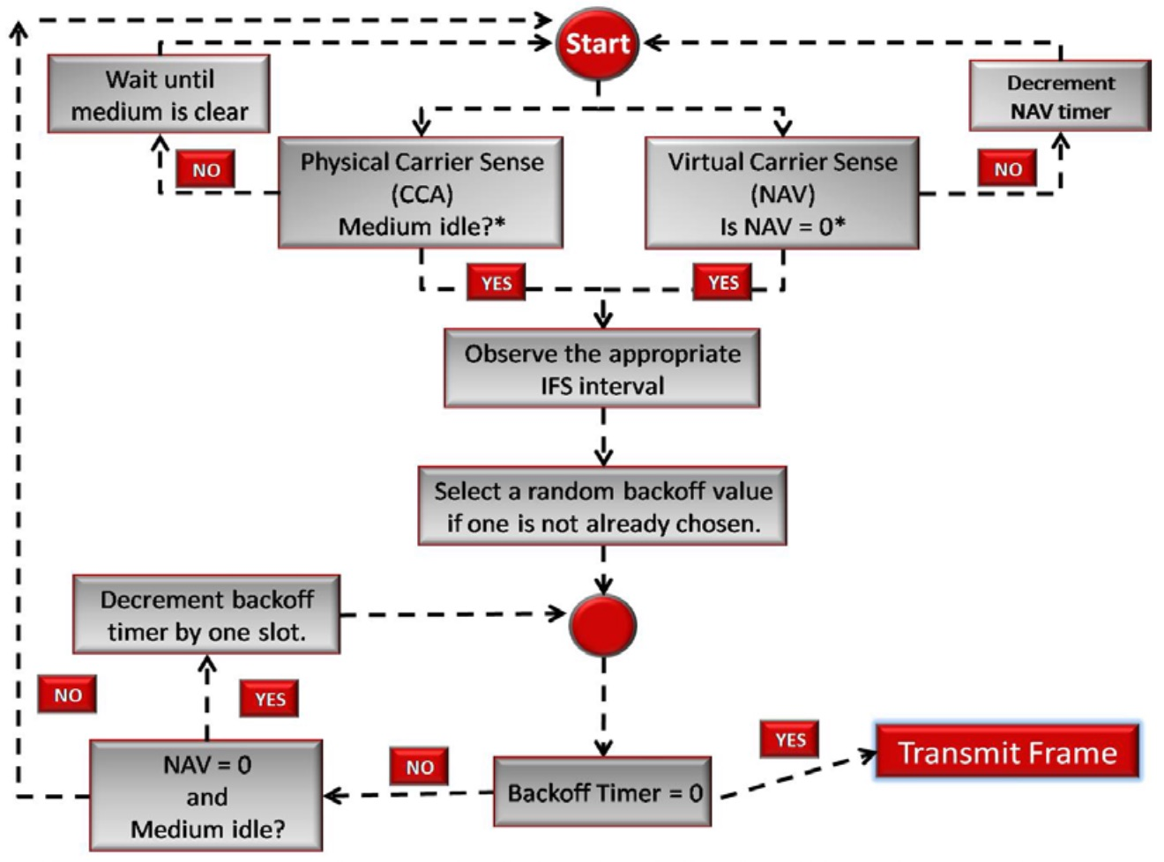
Notes:
IFS – Interframe Space (could be SIFS, DIFS, AIFS, PIFS or EIFS)
Most IFS lengths are 9 or 20 microseconds
Random backoff value – arbitrary and selected by each client
Keeps all STAs from transmitting at same time (if all NAVs = 0)

Slide 22
Are You Interested in Wi-Fi as a Career?
Start with CWNP www.cwnp.com
Leading Wi-Fi vendors have online training (Cisco, Aruba, Aerohive, Ruckus, Mojo, etc.)
Wi-Fi blogs, webinars, YouTube, mentors
www.gcatewifi.wordpress.com for list of Wi-Fi blogs
Notes:
CWNP is a great organization!
Next slide: The reason you all came out tonight—to get your Wi-Fi at home fixed!

Slide 23
Can You Fix My Wi-Fi at Home?
The Need for Speed:
Size and speed of your home ISP?
This is usually the bottleneck
Get at least 20/2 (DL/UL)
Realize this is a “shared” internet circuit. Evenings and weekends are always busy!
Notes:
Spectrum has default of 100/10 now, I think.
Get fastest you can as this is usually the bottleneck
WLAN engineers say “80% of wireless issues are client-related.”

Slide 24
Can You Fix My Wi-Fi at Home?
Do you have Wi-Fi at home now?
Is it an ISP provided AP? If so, they may have incorrect settings (more on this later)
Be sure your AP (router) is in center of home
If AP not provided, then buy one (Cisco-Linksys, Netgear, D-Link, TP-Link, Ubiquity, etc.)
All have web page for setup (change admin pw!)
Notes:
Your ”Router” at home is a multi-function device: It is an AP and firewall and switch and router, etc.
Wi-Fi at home:
Incorrect settings by ISP
AP in center of home, if possible (not in corner under pile of clothes)
AP and NOT a “WAP”

Slide 25
Can You Fix My Wi-Fi at Home?
“I have a big house and need more APs!”
Cloud-based APs are good (Ubiquity, Open Mesh, Cisco Meraki are all good). Connected via Ethernet cables
Mesh APs (Eero, Google Wi-Fi, Netgear Orbi)—they all “talk” to each other
Use same SSID (network name) on all APs
Notes:
Cisco Meraki – yearly/three-year subscription fee; these others do not.
Same SSID: You want to roam to the other AP, and the client always makes the roaming decision.

Slide 26
Can You Fix My Wi-Fi at Home?
80% of Wi-Fi problems are client-related
Check your WLAN NIC drivers (Windows, Android, Mac OS, iOS)
Check your OS updates (Windows, Mac, Android)
Changed password lately?
Notes:
Drivers are probably the #1 item in this list!

Slide 27
Can You Fix My Wi-Fi at Home?
Wi-Fi Settings (the ”correct” ones!)
2.4 GHz: Only on channels, 1, 6 or 11
Use a mobile app to see what channels are in use
Be sure channel bonding is set to 20 MHz only!
5.0 GHz: All channels are OK to use
Use a mobile app to see what channels are in use
Keep channel bonding to 40 or 80 MHz, not 160
Notes:
2.4 –ONLY use channels 1, 6 or 11 (unless you are in middle of Montana!)
Use 5 GHz if at all possible, especially in congested neighborhoods, apartments or condos

Slide 28
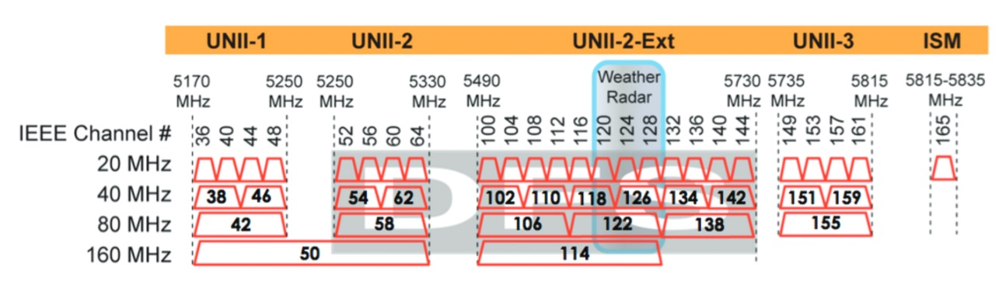
5 GHz Band (US Regulatory Domain)
Notes:
UNII-1 and UNII-3 are always safe to use
UNII-2 and UNII-2 Ext are DFS channels – if detect radar, must change channel
Near and around airports
Near terminal doppler radar sites
For home use, usually OK to use, but be aware channel may change

Slide 29
Can You Fix My Wi-Fi at Home?
Wi-Fi Settings (the ”correct” ones!)
Channel/power levels: suggest manual channels and power levels at 17 dBm (50 mW max). Use 14 dBm if you can.
Data rates: If you can, disable (on 2.4 GHz) 1, 2, 5.5 and 11 Mbps rates, your network will run faster.
Data rates: Check 5.0 GHz. OK to use, 6, 12 and 24 as basic rates.
Leave all other settings as “default” (unless you know what you are doing)
Notes:
Use “automatic” on channels in the 5 GHz band if there are a lot of other APs on this band.
Disable 1, 2, 5.5 and 11 – these are 11b rates (over 17 yr old technology). Eliminate protection mechanism and pm ripple
5 GHz: 6, 12, and 24 Mbps are usually the default settings

Slide 30
Can You Fix My Wi-Fi at Home?
Wi-Fi Settings (the ”correct” ones!)
SSIDs (network name): Use a simple one
C or A or J. Not your last name or your dog, cat, etc.
Setup a Guest SSID (call it G, not guest)
Password: Use WPA2-PSK
8 characters needed; pick something easy to remember
Amat3ur! (8 characters: U.C., L.C., number, special character)
Flash your router with latest firmware update
If your router is “old”, buy a new one! (802.11ac device)
Notes:
Firmware updates are done by looking in the web GUI on your router
New routers are $100 or less and will dramatically improve your home wireless network!
Recent ones on Amazon:
TP-Link Archer AC1750: $59.99
Netgear R6700 Nighthawk AC1750: $99.99
Asus AC1900: $139.99
Get an 802.11ac router (11n is older)

Slide 31
Q & A ?
Notes:
Slide deck will be up on the SPARC website

Slide 32

TKS ES 73 DE N4GRC
@grcate
gcatewifi.wordpress.com
www.linkedin.com/in/grcate

