Slide 1

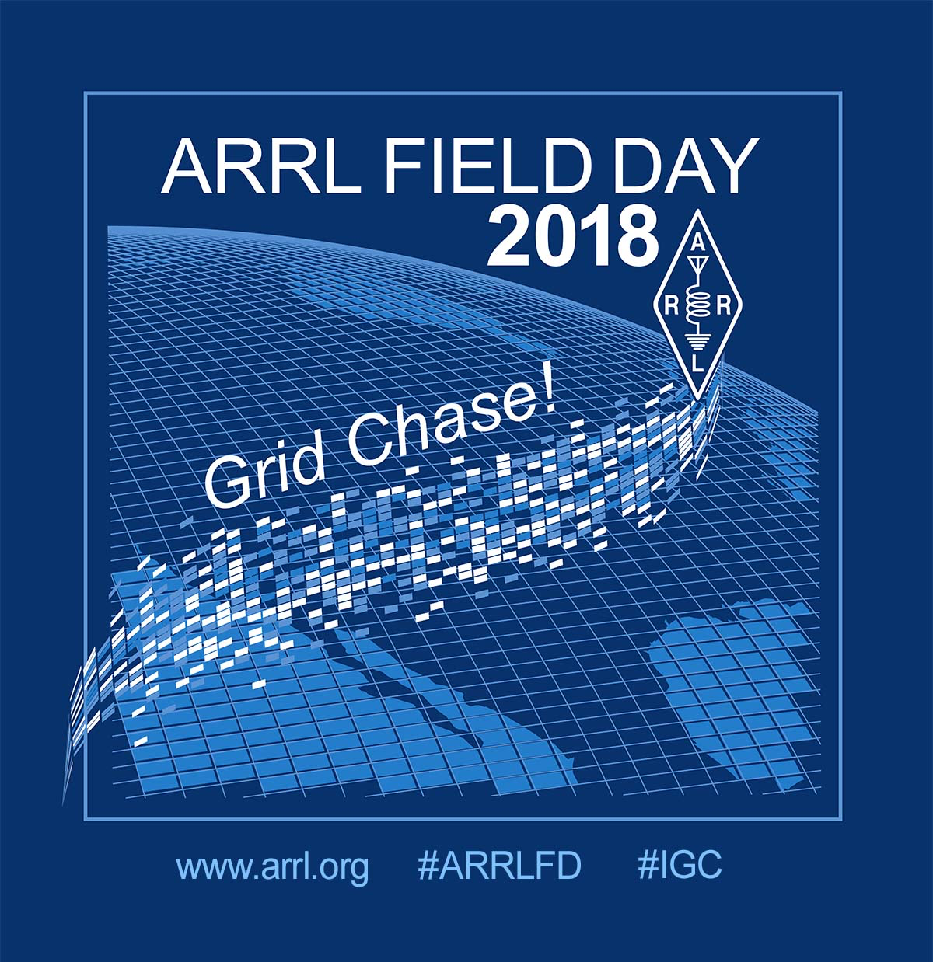
ARRL FIELD DAY SIMPLIFIED
Original presentation by TIM BUBIER, WT1A

Slide 2
Time to start thinking about
Field Day 2018!
June 23 – 24, 2018
Who, what, where, how?
Why?

Slide 3
Field Day 2018
This slideshow will attempt to explain:
  Why?
  How?

Slide 4
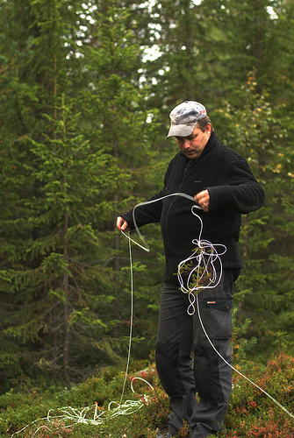
Field Day Simplified
Purpose of Field Day
Basic Rules
The Contact Exchange
Scoring
Station Setup
Strategies

Slide 5
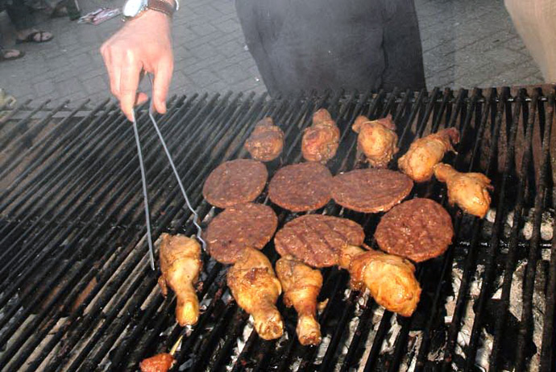
Field Day Purpose
Social gathering
  Eating and drinking
  Camaraderie and friendship
Emergency Preparedness
  Training ourselves
  Demonstrate emergency preparedness to public, government and served agencies
  Experimentation with antennas, portable equipment and unusual power sources

Slide 6
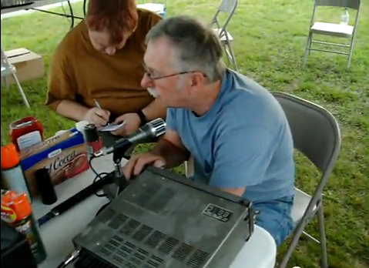
Field Day Purpose (cont.)
Chance to try out new/different equipment
Knowledge building
Recruiting new hams and potential members
Challenge of operating in abnormal situations and less-than-ideal conditions
Competition
FOOD AND FUN!

Slide 7
Objective of Field Day
To work as many stations as possible on any and all amateur bands (excluding the 60, 30, 17, and 12-meter bands – no repeaters) and to learn to operate in abnormal situations, in less than optimal conditions.
Field Day is open to all amateurs in the areas covered by the ARRL/RAC Field Organizations, and countries within IARU Region 2
DX stations residing in other regions may be contacted for credit, but are not eligible to submit entries.

Slide 8
Motivation
Many hams profess no interest in operating radio on Field Day, but in reality they’re reluctant to participate because of:
  “Mike Fright” (or “Key Fright”)
  Unfamiliar with radio procedures in general
  No experience on HF (but ham radio is more than 2 meter repeaters)
  “Don’t like contests”

Slide 9
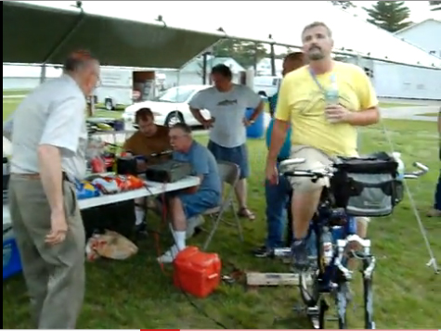
So…
What’s your excuse?
  You don’t have to be a “super-ham” to operate Field Day
  We’re here to help
  you out. Don’t be
  hesitant to ask.
  You can “play” as little
  or as much you’d like

Slide 10
WHO CAN OPERATE FIELD DAY?
ANYONE
  LICENCED HAMS CAN OPERATE ON THEIR OWN UNDER THE NORMAL RESTRICTIONS OF THEIR LICENSE, OR ON UNDER THE PERMISSIONS OF A CONTROL OPERATOR
  NEWLY-LICENSED OR NON-LICENSED PEOPLE ARE ENCOURAGE TO OPERATE THE GOTA STATION

Slide 11
What are we trying to accomplish?
Contact as many other stations as possible
On any and all amateur bands (excluding the 60, 30, 17, and 12 meter bands)
And in doing so, to learn to operate in abnormal situations in less than optimal conditions.
A premium is placed on:
  developing skills to meet the challenges of emergency preparedness
  acquainting the general public with the capabilities of Amateur Radio

Slide 12
Field Day Entry Categories
Are based on:
  Number of transmitters
    Total number of transmitters operating on Voice (SSB, AM, FM), CW (Morse Code) and Digital Modes
    The Get On The Air (GOTA) station, along with a VHF/UHF station, do not count toward this number
  Where the Station is located
    In the “field”, at home, at an EOC, mobile, etc.
  How Transmitters are powered
    Emergency Power (Generators), Batteries, Solar, etc.

Slide 13
OUR OPERATION
We generally set up on Saturday morning, go through the night and then break down sometime on Sunday around noon.
We will operate 3 HF stations (CW, Phone and Digital). CW as long as we have ops then maybe digital.
We also have a dedicated VHF (6 meter) station as well as trying to make satellite contacts for bonus points

Slide 14
OUR OPERATION
We operate primarily on generators. We use solar charged batteries for Natural power bonus

Slide 15
OUR OPERATION
                ?
                Where and how do we want to operate this year?

Slide 16
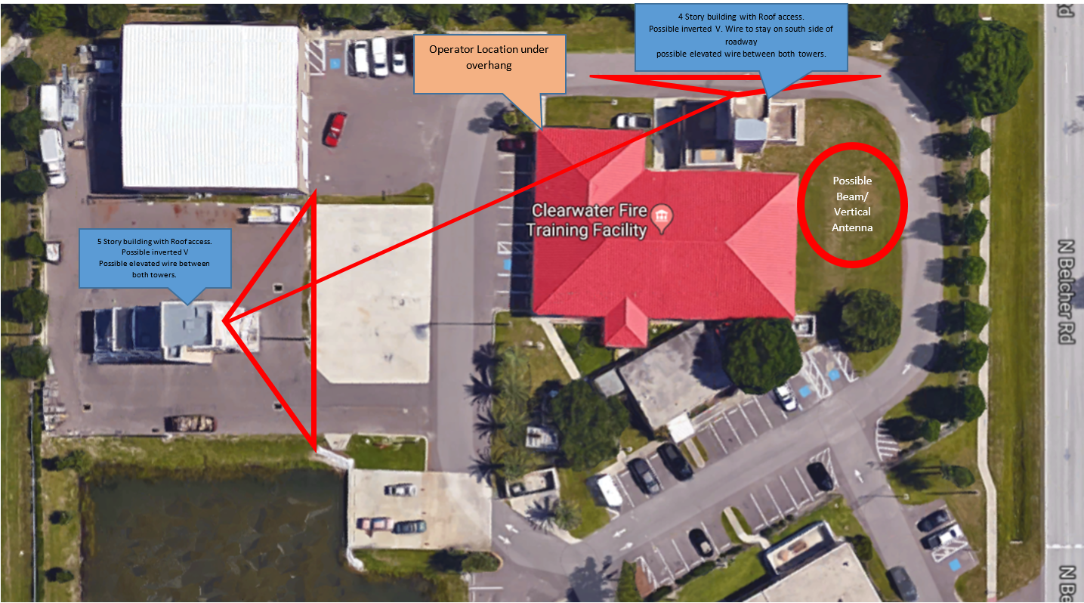
Clearwater Fire Training Center
Our suggestion:

Slide 17
LOCATION, LOCATION, LOCATION
Site used for Winter Field Day
50 foot tall fire tower for beam and slopers
Second tower for VHF station and talk-in

Slide 18
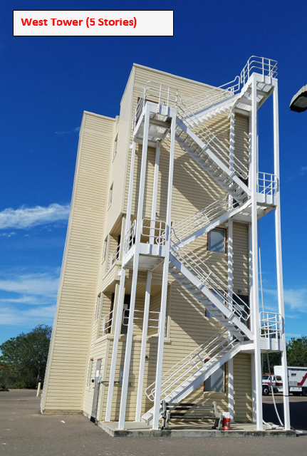
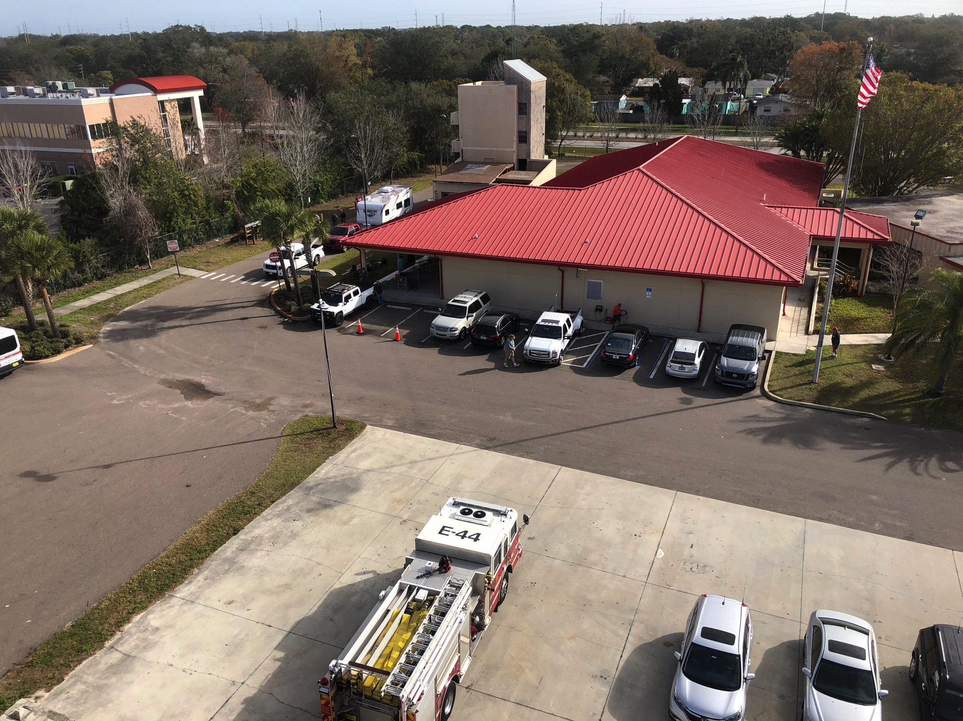
Tall buildings!

Slide 19
THE BASIC RULES
No new rules for 2018
All transmitters must be within a 1000 foot circle
All transmitters must use the same call, W4TA

Slide 20
MORE RULES
Phone, CW, and Digital are considered separate “bands”
All voice contacts (SSB, FM, AM, satellite) are equivalent (1 point each)
All CW and digital contacts (PSK31, RTTY, Packet, Pactor, etc.) are equivalent (2 points each)
No cross--band contacts (exc. Satellite)
Only one xmtr per “band” at any time

Slide 21
CONTACTS
Can only work each station once per band-mode:
  For example, you can work the same station once on 20M phone, once on 20M CW, and once on 20M digital mode (total 5 points)
  You can work the same station on other frequency bands and modes for additional points.

Slide 22
The Contact “Exchange”
In order to make a valid contact, the information to be exchanged consists of:
  Number of transmitters at your site (3 for example)
  Class of operation (A most commonly, F from EOC)
  ARRL Section, State, Province or Part of State (WCF for us)
So, for us:
  On CW – “3A WCF”
  On Phone – “Three Alpha Whiskey Charlie Foxtrot”

Slide 23
Exchange must be accurate
You must copy the information correctly from the other station AND…
The other station must copy your information correctly, OR ELSE…
It is not a valid contact and will be deducted from our final score

Slide 24
ARRL Section
71 US and 12 Canadian Sections
Basically each US state (PR and US VI) and Canadian province
Some states/provinces are divided into multiple sections:
  FL is 3 sections (NFL, WCF and SFL)
  Massachusetts is 2, Eastern and Western (EMA & WMA)
  New Jersey is 2 sections, Northern and Southern
  Texas is 3 sections
  Ontario is now 3 sections
  New York is 4 sections
  California is 6, etc.

Slide 25
ARRL Sections (continued)
Each section has a unique 2 or 3 letter identifier.
Examples:
  ME = Maine
  EMA = Eastern Massachusetts
  LAX = Los Angeles
  WTX = West Texas
  NFL = Northern Florida
List can be found at each station and is prominent on most logging software – keeps track of worked sections and ones still needed.

Slide 26
BONUS POINTS
DON’T JUST STAND AROUND – WORK ON THOSE BONUSES!
HERE’S WHY AND HOW:

Slide 27
BONUS POINTS
100% Emergency Power – 100 points per transmitter (except GOTA, VHF/UHF and Satellite)
  Support equipment and peripherals (like computers, lights, etc.) can be on regular commercial power
Media Publicity – 100 points
Public Location – 100 points
Originating a Message to Section Manager – 100 points.
Handling Messages – 10 points per, max 100 pts.

Slide 28
BONUS POINTS
Satellite QSO (just 1) – 100 points
Demo of Natural Power – 100 points (bicycle generator, solar panel, wind turbine)
  Need to make 5 contacts minimum
  Counts as one of the transmitters while in use
  Includes batteries charged by alternate power (like a solar panel, for example)
Copying the special CW FD Bulletin from W1AW. (must be copied over the air) – 100 points

Slide 29
BONUS POINTS
Site Visit by an invited Elected Government Official (Fire Chief?)– 100 points
Site Visit by Served Agency Group Rep. (Red Cross, Salvation Army, local EMA, Law Enforcement, etc.) – 100 points
Public Information Table – 100 points
Educational Activity (must be a “related to amateur radio” and a “formal activity”) – 100 points

Slide 30
BONUS POINTS
Web Submission of Field Day entry (when sent in to the proper web sit) – 50 points
Youth Participation – 20 points for each participant age 18 or younger who completes at least one QSO
  Max. of 100 points

Slide 31
Basic Field Day Operating Strategies
Search and Pounce (S&P)
  You roam around the bands looking for other stations calling CQ
Calling CQ
  You sit on an open frequency and call CQ waiting to others to respond

Slide 32
Search and Pounce (S&P)
You can be selective about who you contact
Useful in contests where multipliers are ARRL sections, DX zones
You can intentionally avoid stations with big pile ups (many stations calling the same station) which wastes time and reduce your “Q Rate” (number of contacts (QSOs) per minute or hour)
You must check the log to make sure the calling station is not a “Dupe” (duplicate of earlier QSO)

Slide 33
Calling CQ
You never know who will answer
May not work as many multipliers (sections)
Usually can work a lot more stations (more points, higher “Q Rate”)
Can be even easier using a voice keyer (recorded voice message)
May have to handle a pile-up (good practice for upcoming W1AW/1 operations)
Can get tiring if you call by voice and no one answers

Slide 34
Example of Good Phone Exchange
You call: CQ Field Day, CQ Field Day from W4TA, Whisky Four Tengo Alpha
Someone answers: W4TA here is November Four Alpha Whiskey Baker
N4AWB, please copy Three Alpha, West Central Florida
QSL, please copy Four Alpha, South Florida, Four Alpha SFL, over
QSL, thanks for South Florida and good luck in Field Day. QRZ from Whiskey Four Tengo Alpha

Slide 35
Bad Example of Phone Exchange
You call: CQ Field Day, CQ Field Day from W4TA, Whiskey Four Tengo Alpha
Someone answers: W4TA from November Four Alpha Whiskey Baker. Four Alpha South Florida
N4AWB didn’t give you a chance to get his call before he sent his exchange and section. You are probably still trying to type in his call and he’s wasting time by giving it all at once so you need to ask him to repeat.
Take your time and make sure you get everything right before moving on.
Saves time and increases points.

Slide 36
Phonetics on Phone
Phone operators must use the ITU Phonetics:
  A = Alpha
  B = Bravo
  C = Charlie
  D = Delta
  Etc.
A sheet with a complete list is also at each station

Slide 37
OPERATING HINTS
Some good operating strategies for Phone, CW and Digital Modes

Slide 38
Hints for Working Phone
When Searching and Pouncing, enter calling station’s call in software FIRST, this way you don’t waste time calling a Dupe
Use phonetics for all of the exchange.
Repeat the other station’s exchange to make sure you got it right. “Thanks for South Florida” only takes an extra second and can help make sure you got it right the first time.

Slide 39
Hints for Working Phone
Don’t call at station with a pile up more than just a few of times. This wastes time and you can always come back to them later. Chances are, if they’re strong you’ll hear them again and, if they’re not, they won’t hear you anyway.
Don’t be long winded while calling CQ. Call a few times then listen. Call again if no one responds.
Keep your exchanges short and to the point. If you’ve been calling CQ, some stations will be impatient and leave before they call you if you’re going on about the weather and other stuff while they’re waiting.

Slide 40
Hints for Working Phone
Don’t be afraid to ask for repeats. If you can’t hear them the first time or forget to record it, just say, “Please repeat your… (call sign, section, etc.)” If you still can’t make it out, say, “Just you call, your call please” or “Just your section,” etc. That sometimes makes it easier to make out without all the other stuff you don’t need and saves time.
Repeat only if asked.
Be patient – Many new operators on during Field Day

Slide 41
Hints for Digital Modes
PSK31 and RTTY are the most popular Field Day Digital Modes
The macros for Field Day should be set up just like those for CW. In other words, CQ should be something like: “CQ FD CQ FD de W4TA k”
No need for useless data like “thanks for…” or spelling out “West Central Florida”
Digital is a good use of the CW transmitter when there are no CW operators around. It’s easy and pretty foolproof if the right Macros are used.

